Slide 1
Landing Pages

Slide 2
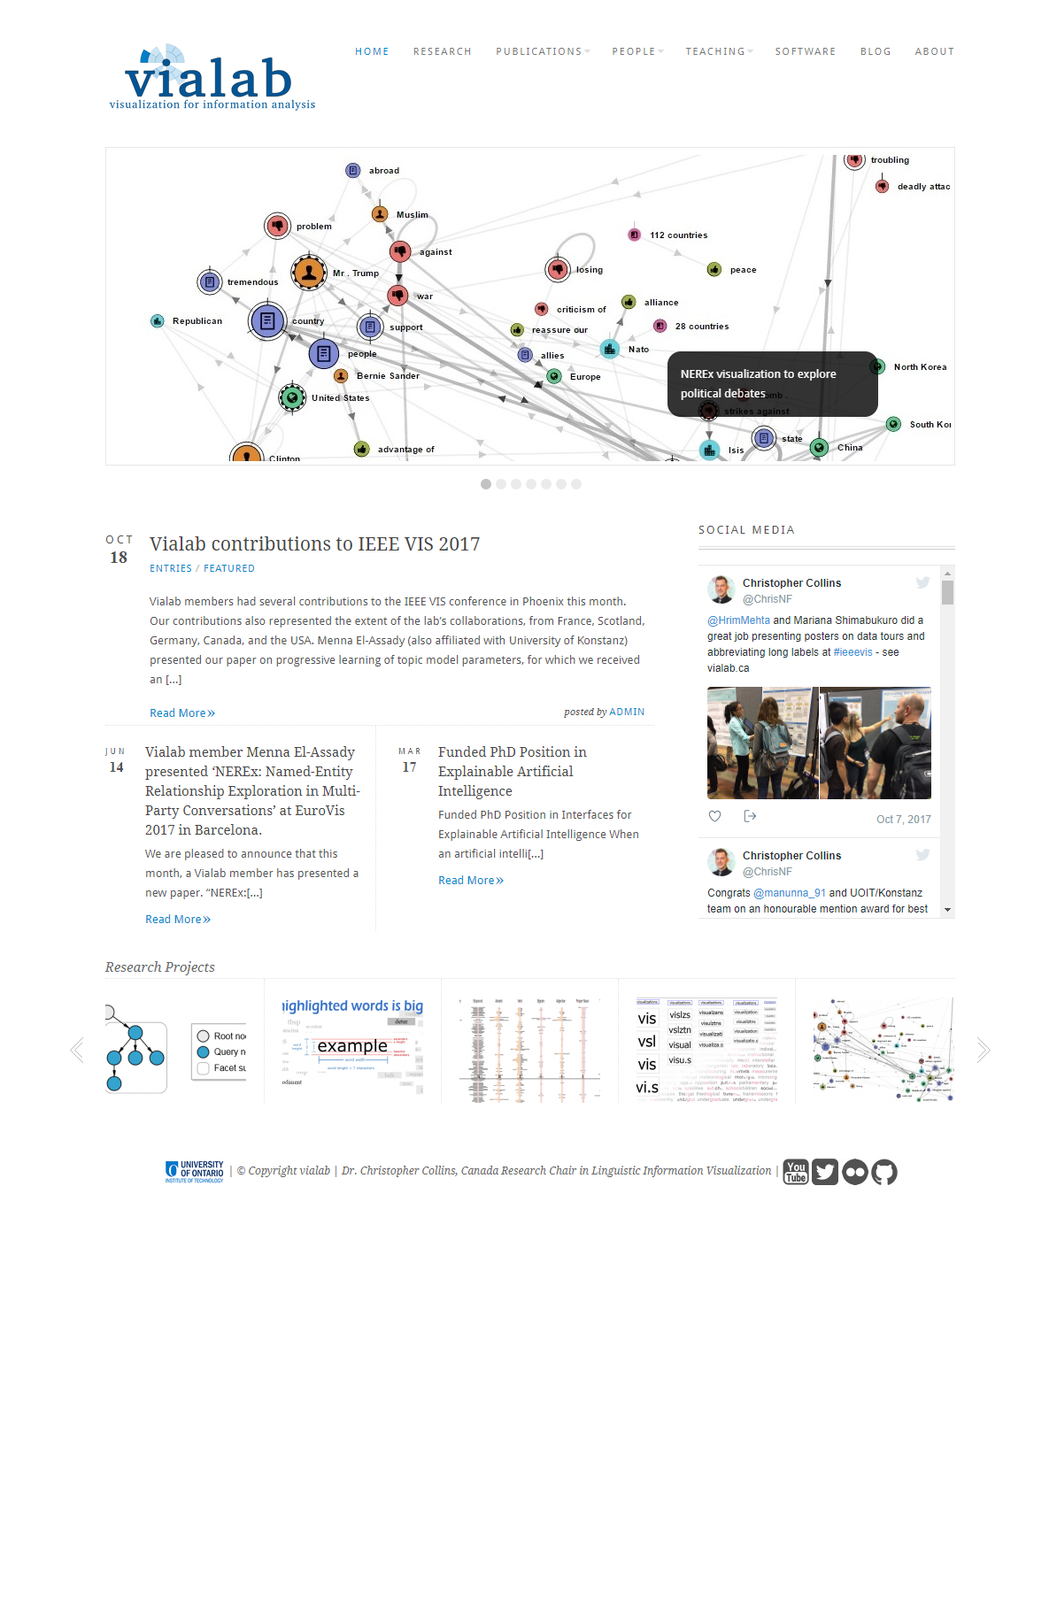
Notes:
http://vialab.science.uoit.ca/
I like how the page handles the news feed

Slide 3
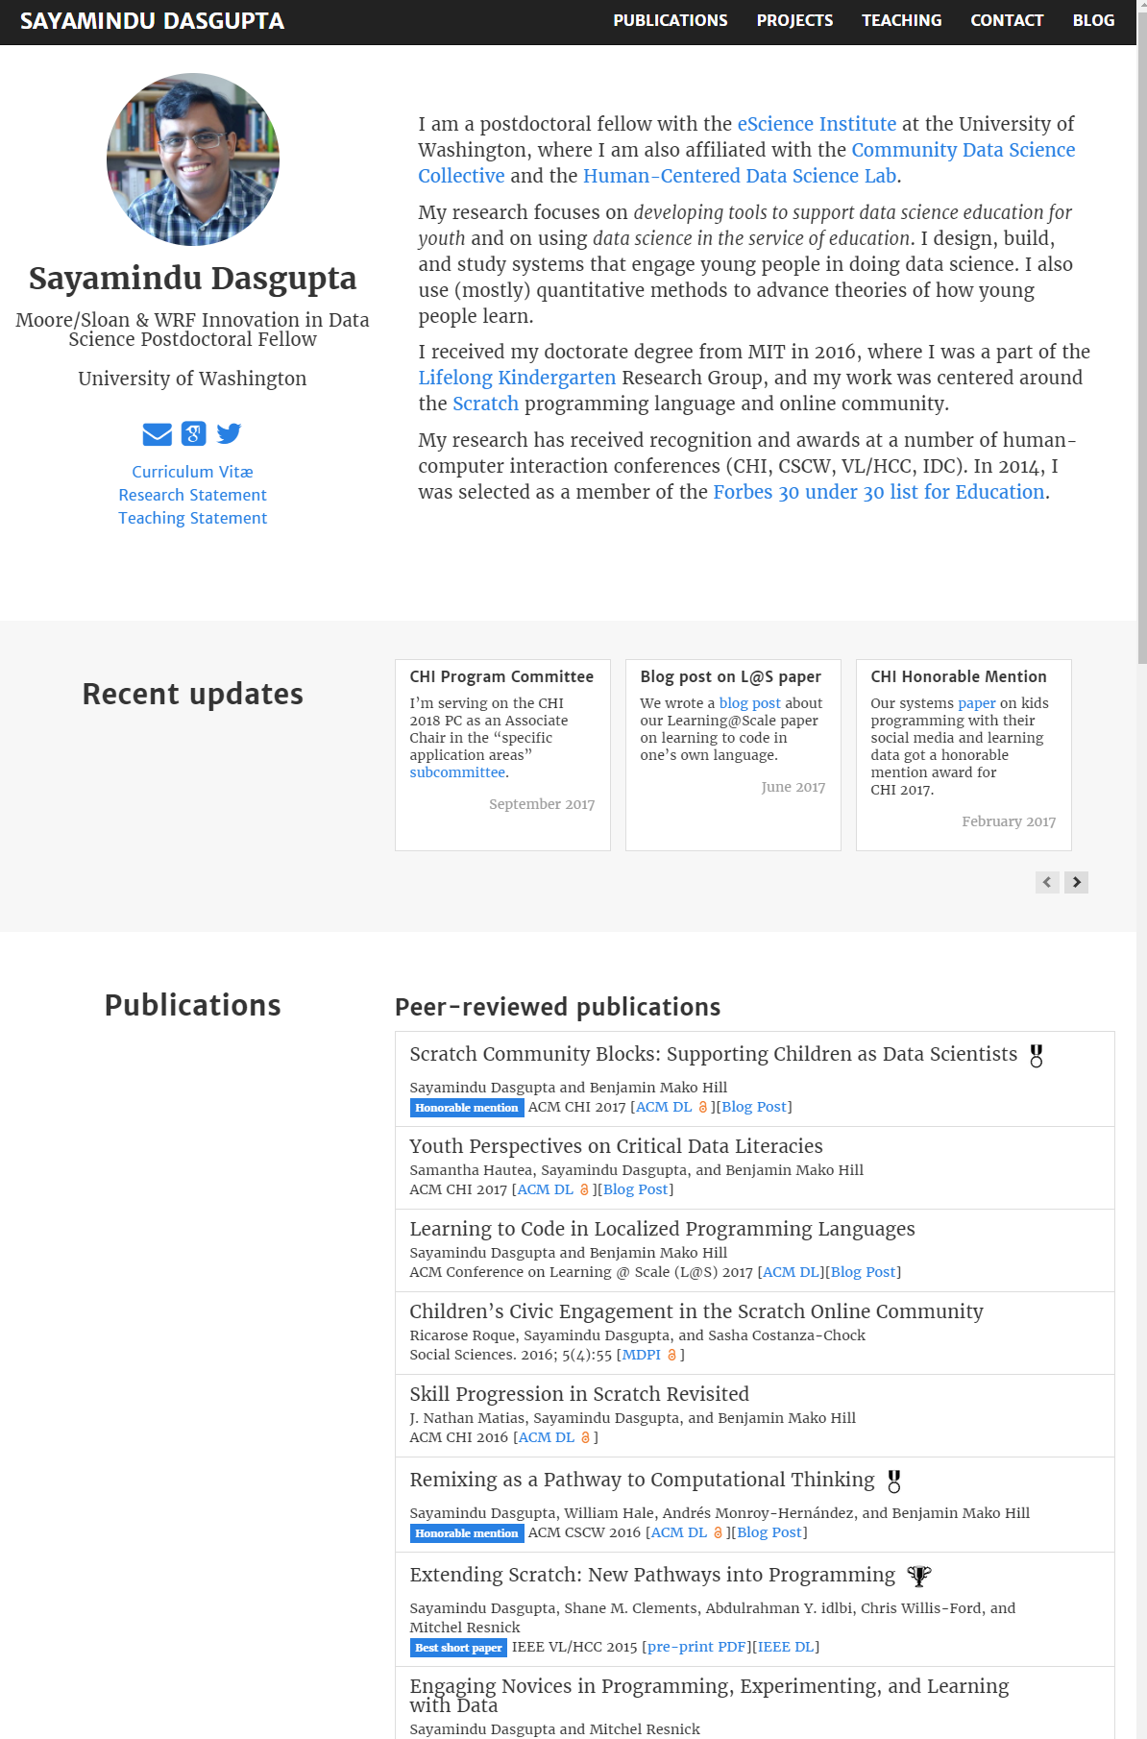
Notes:
A scrolling sideways news feed

Slide 4
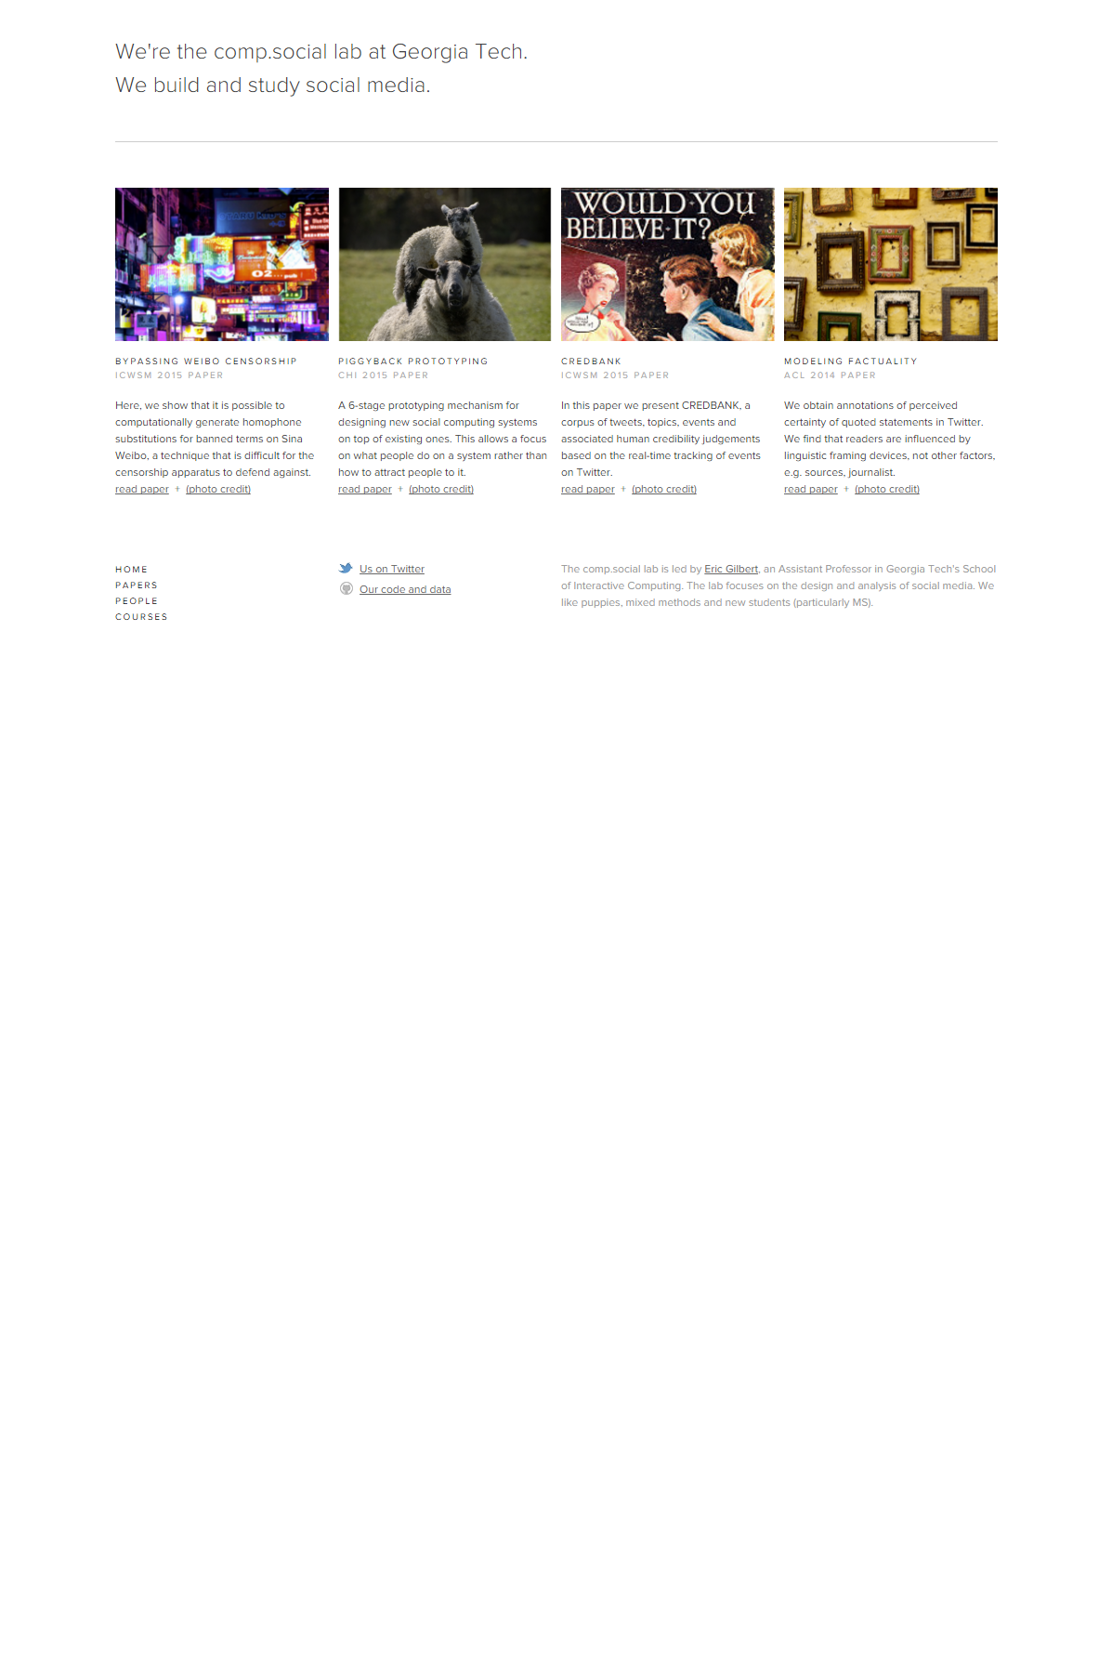

Slide 5
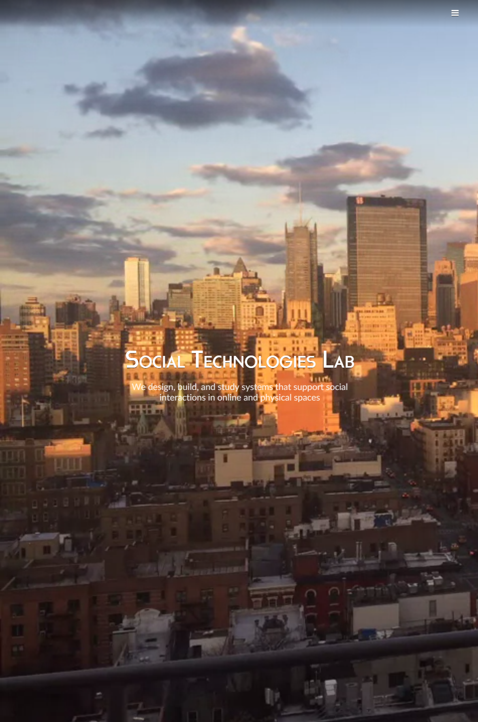
Notes:
https://s.tech.cornell.edu/

Slide 6
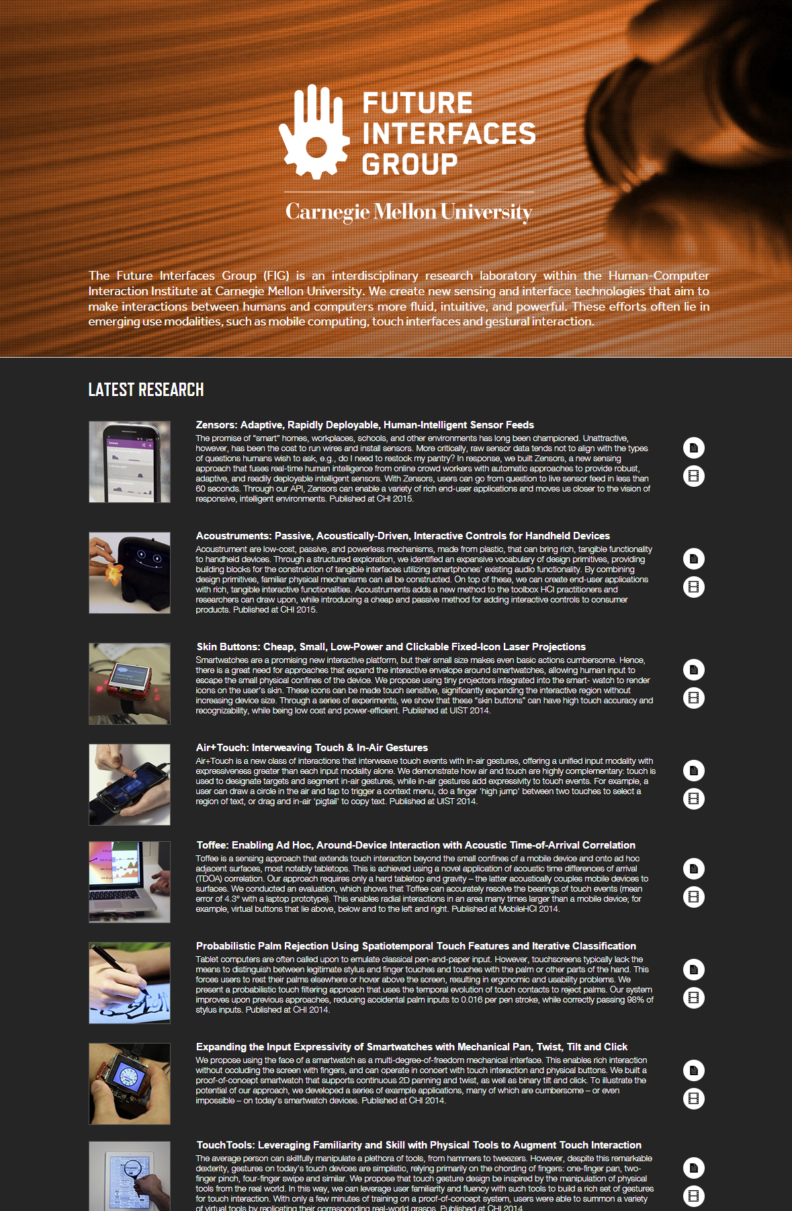
Notes:
http://www.figlab.com/

Slide 7
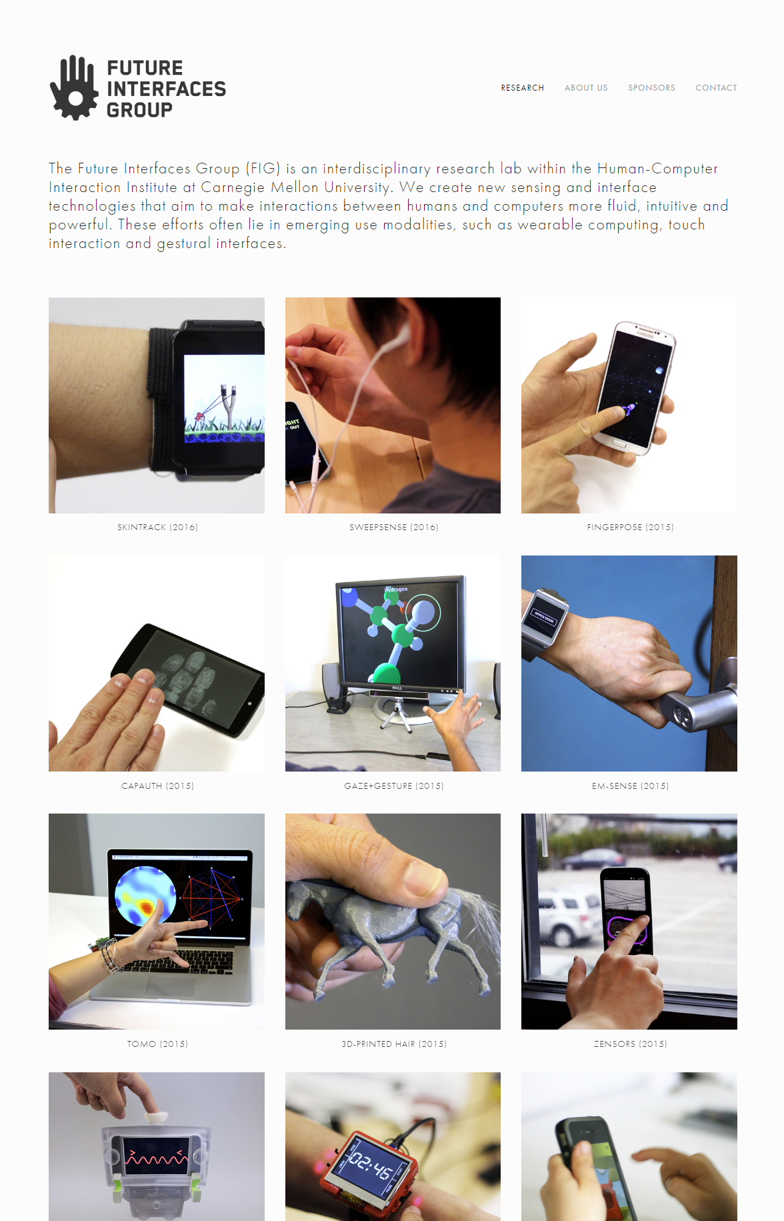
Notes:
http://www.figlab.com/
Uses futura-pt for font

Slide 8
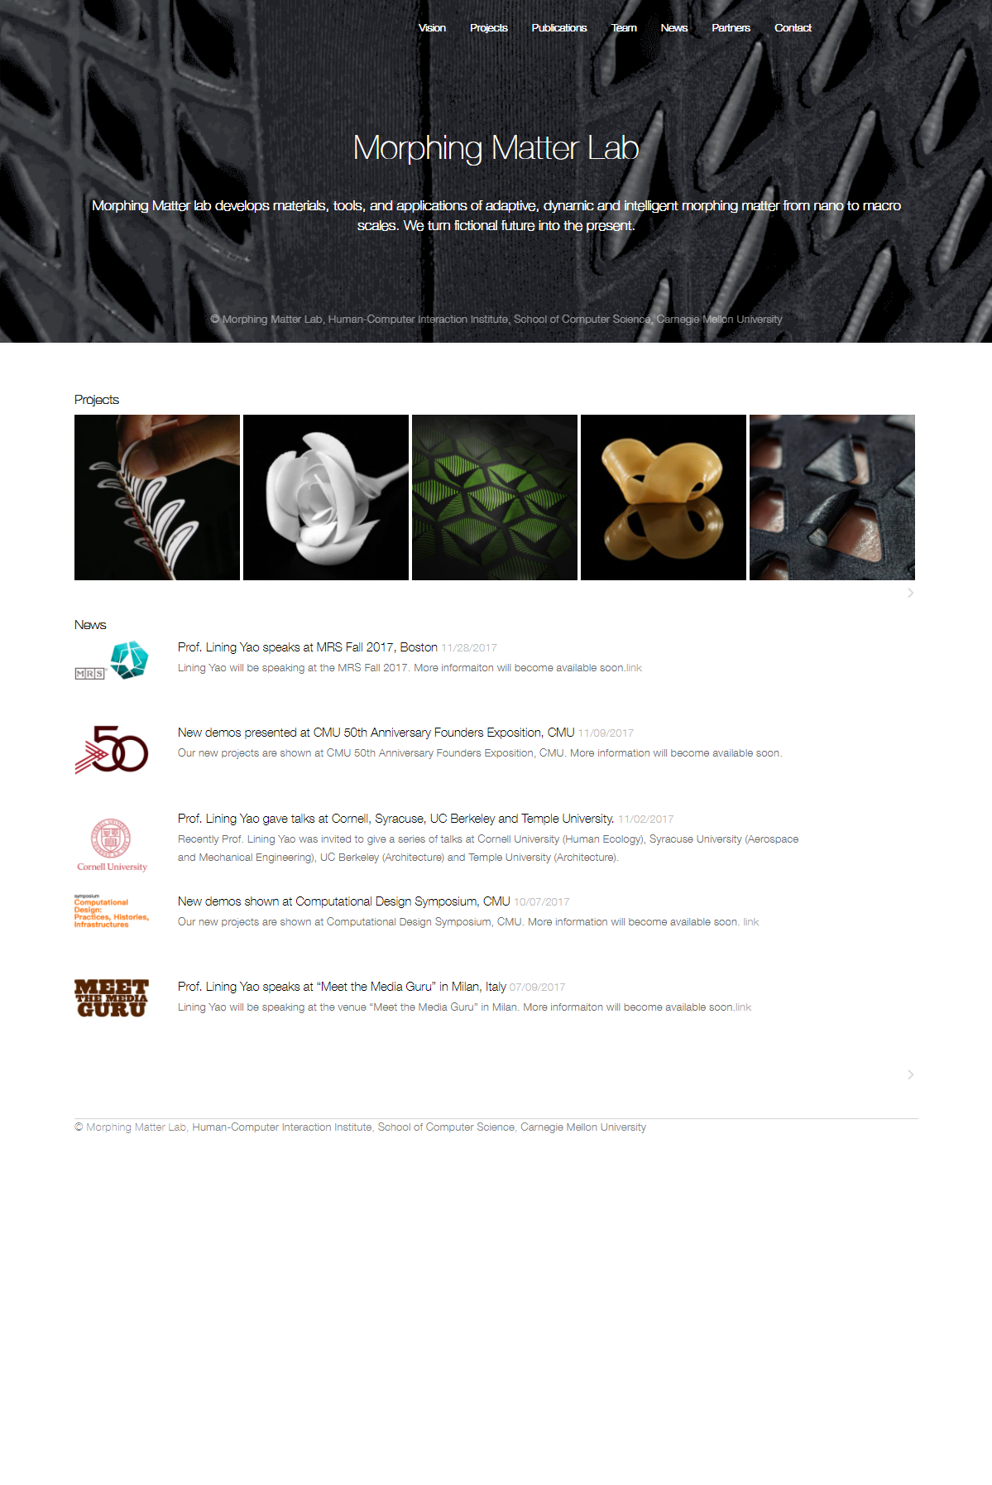
Notes:
https://morphingmatter.cs.cmu.edu/

Slide 9
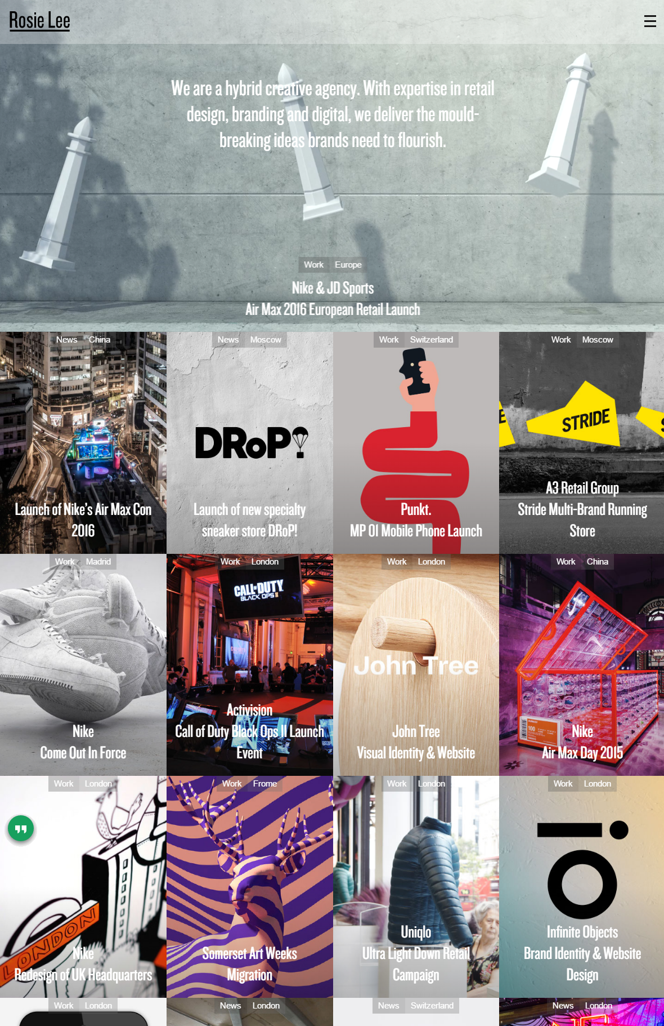
Notes:
http://rosielee.co.uk/

Slide 10
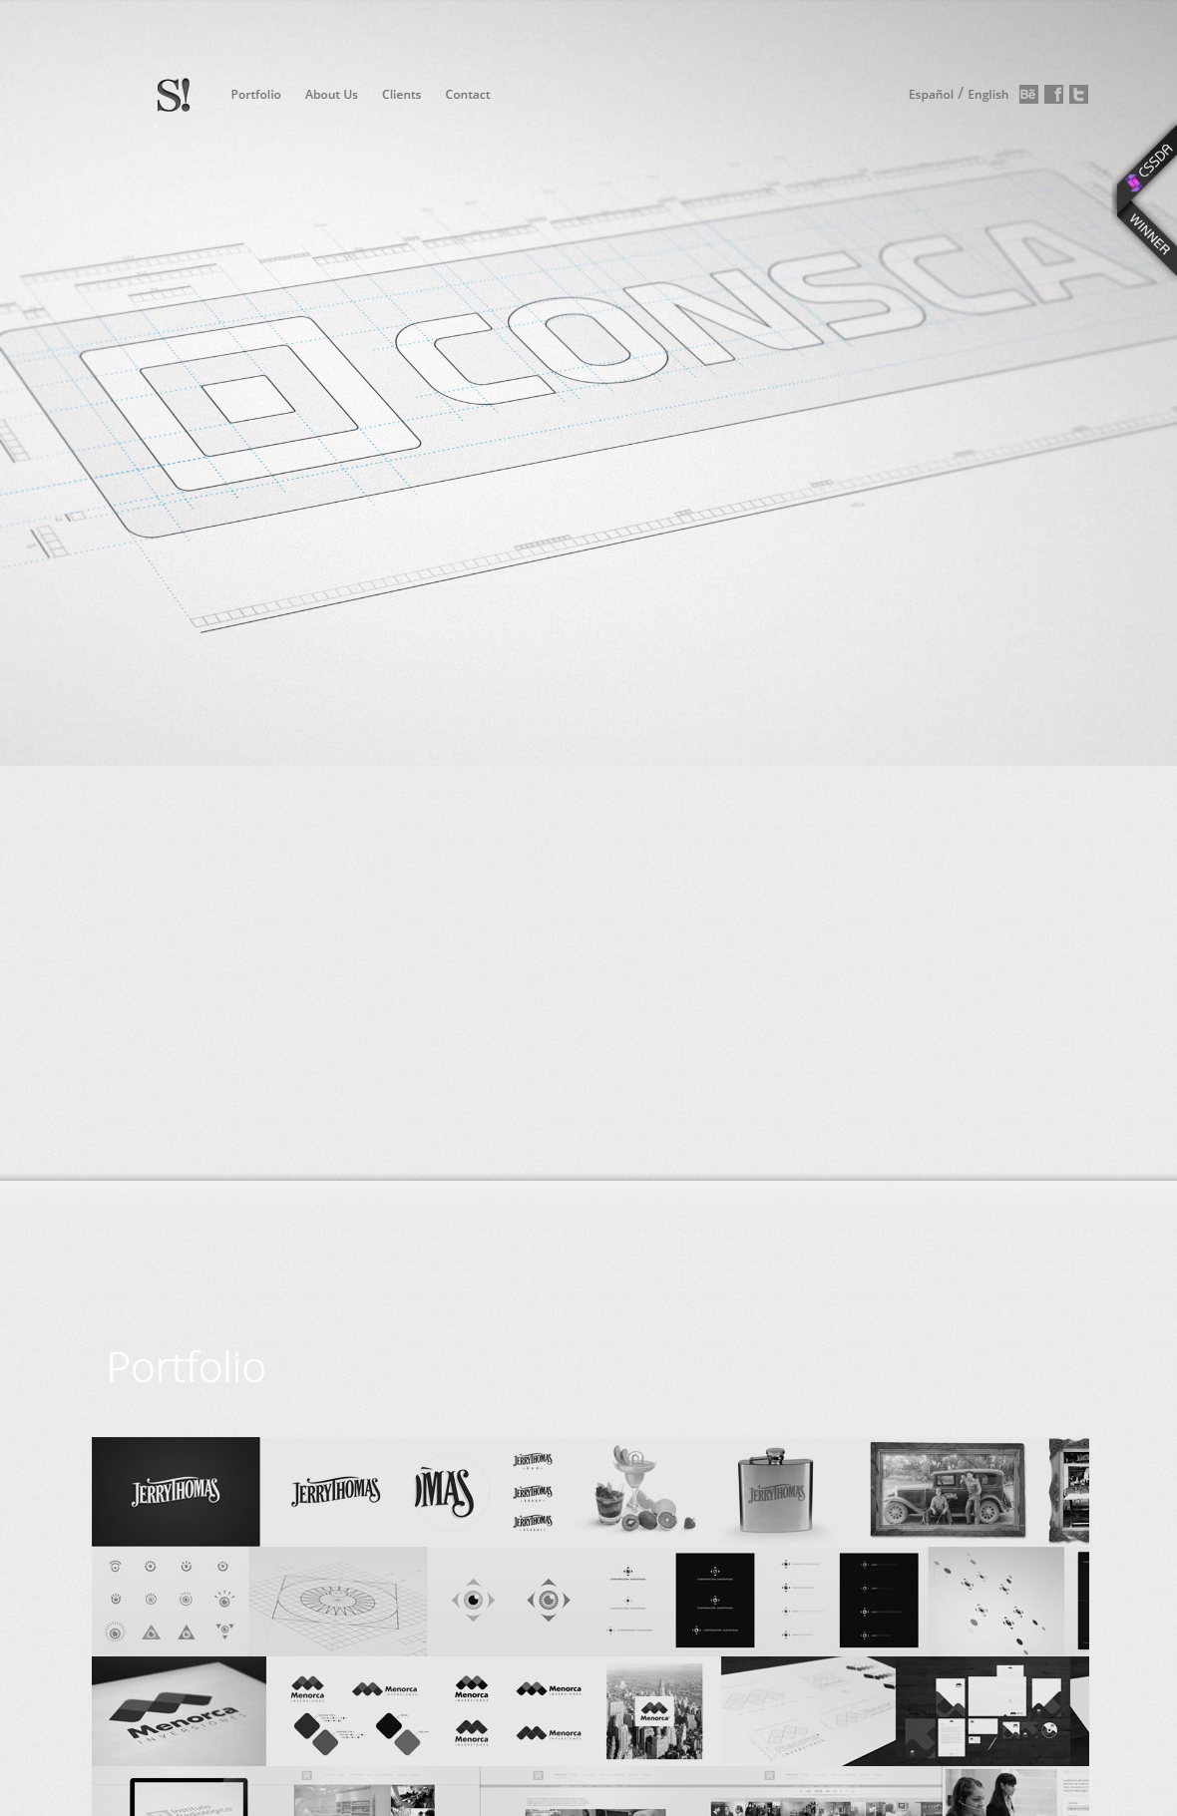
Notes:
http://smartgc.com.ar/english.php

Slide 11

Notes:
https://www.viget.com/

Slide 12

Notes:
http://brandexponents.com/oshin/v21/

Slide 13


Slide 14


Slide 15
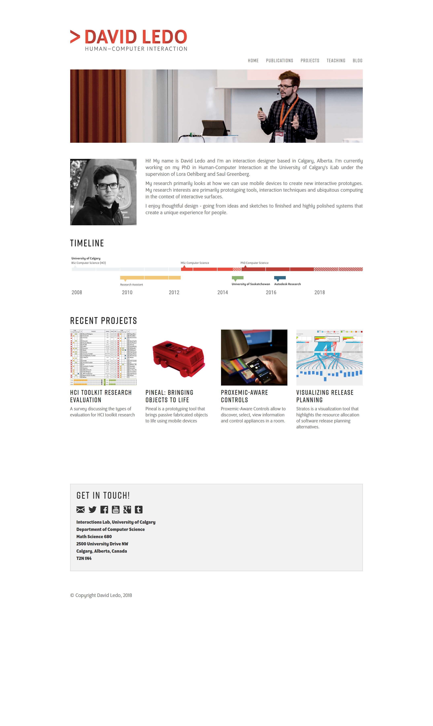
Notes:
http://davidledo.com/index.html

Slide 16

Has cool mouse over animation effect
Notes:
http://themes.webinane.com/wp/electric/portfolio/home-2/

Slide 17
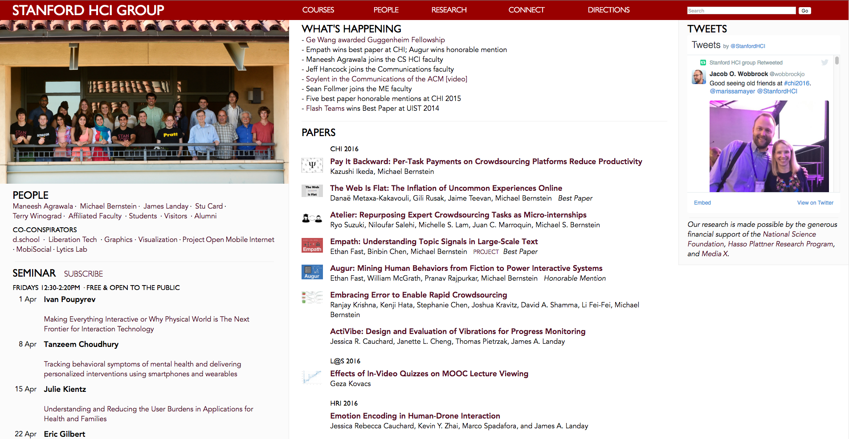
Notes:
http://themes.webinane.com/wp/electric/portfolio/home-2/

Slide 18
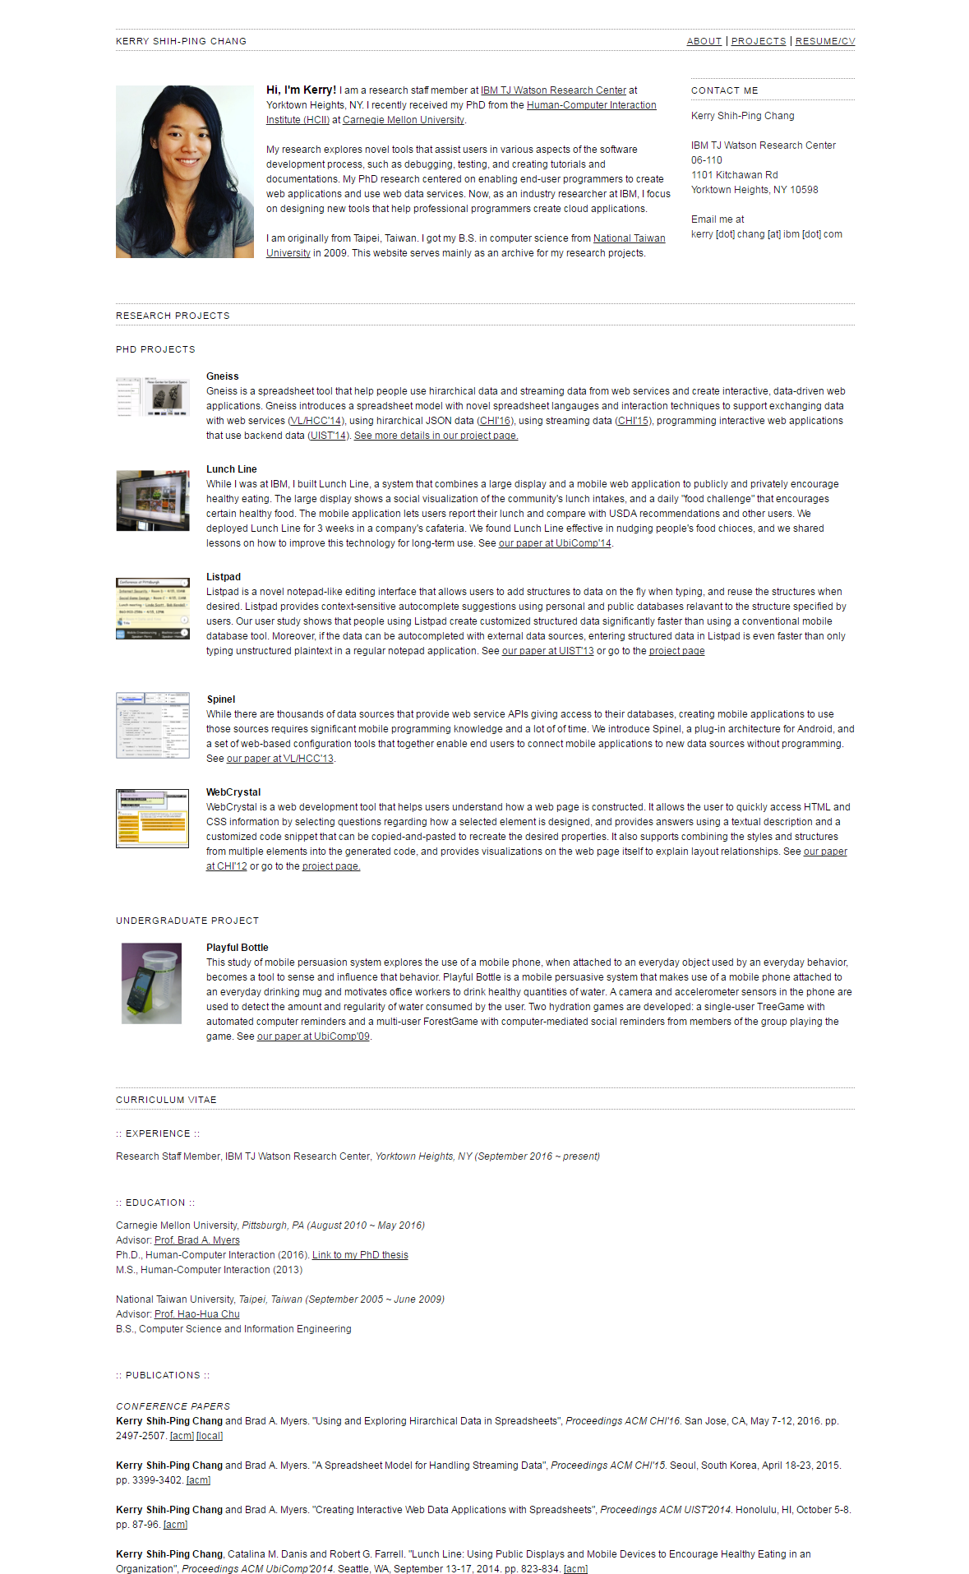
Notes:
Individual academic page (rather than for a research group) but I like it because it’s clean.

Slide 19
Pub Listings

Slide 20
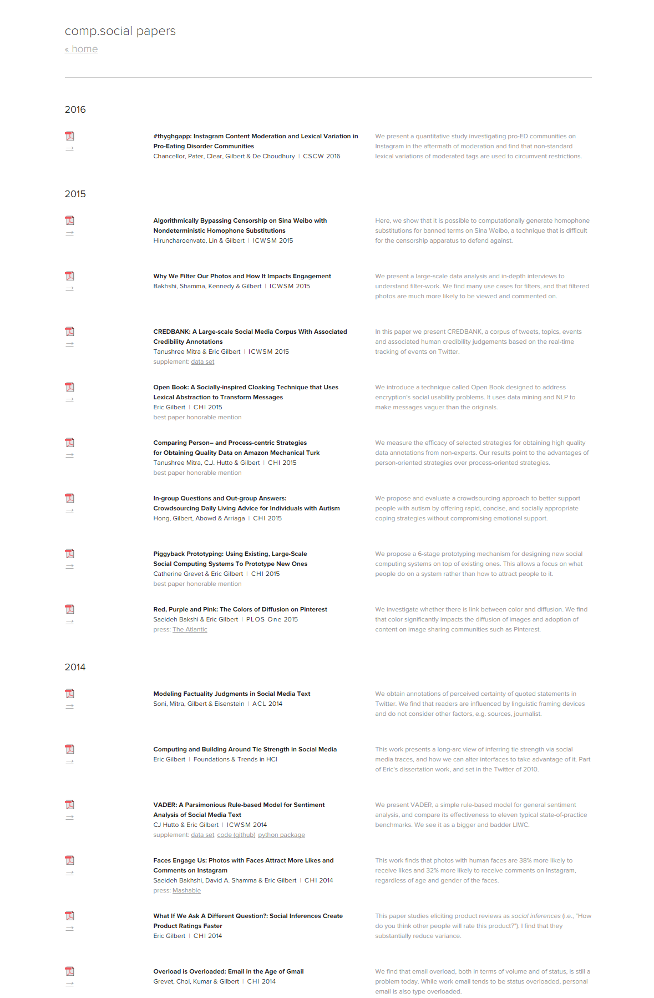

Slide 21
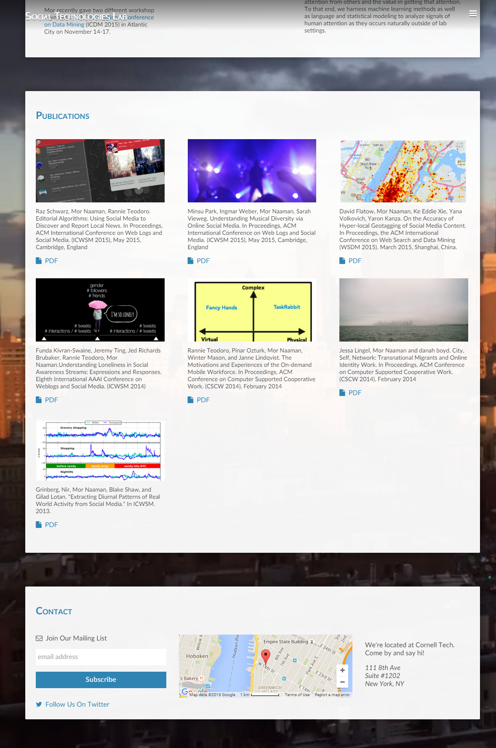

Slide 22
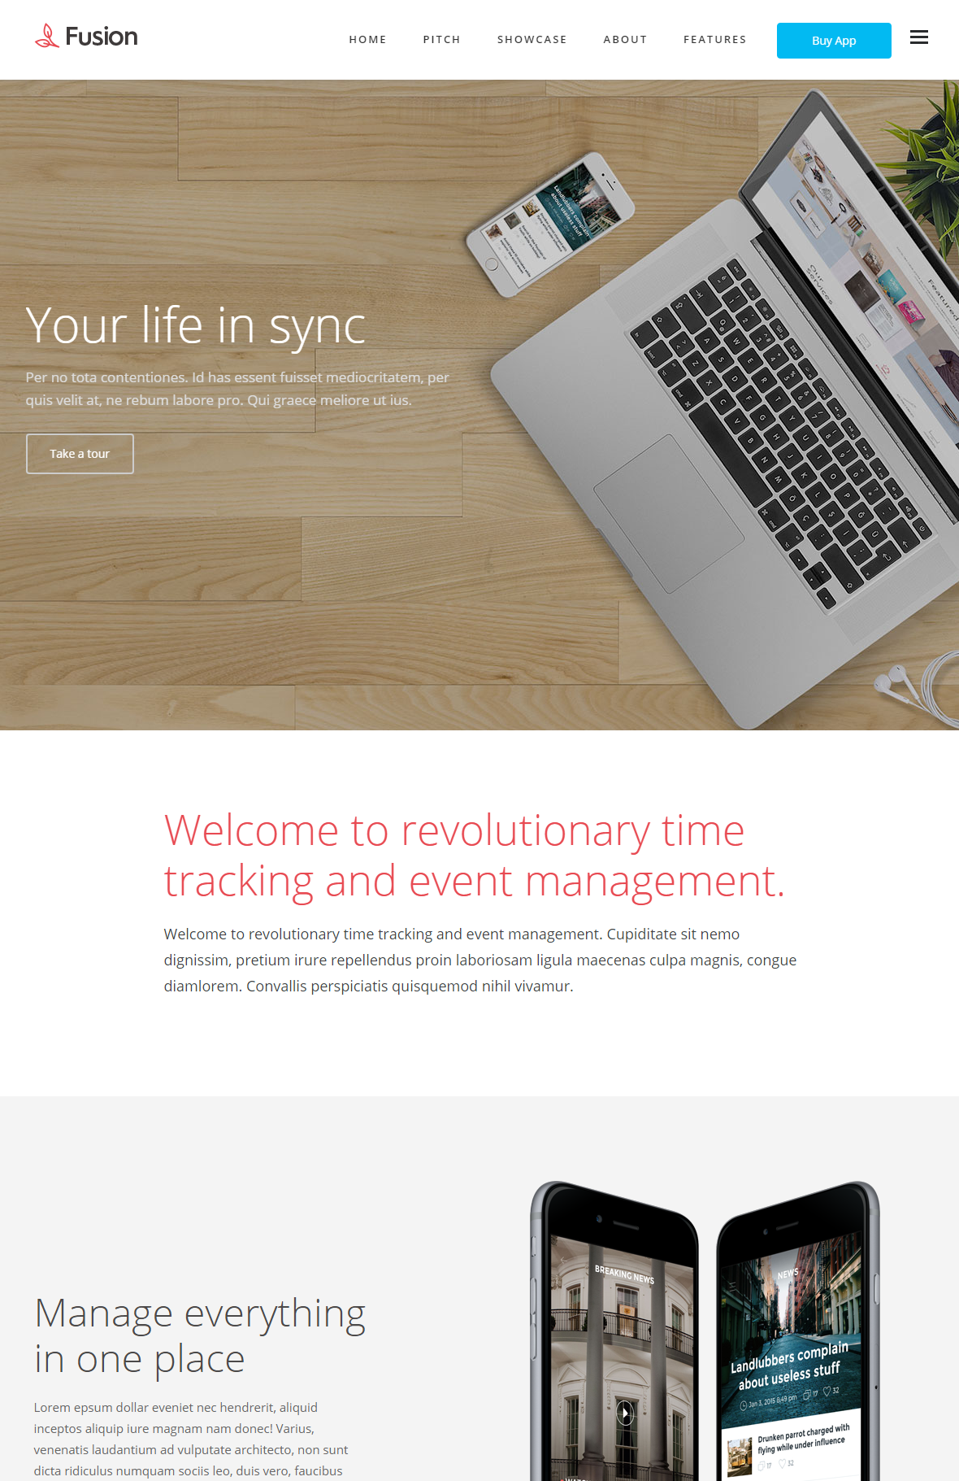
Notes:
http://portfoliotheme.org/fusion
Font family: Open Sans

Slide 23
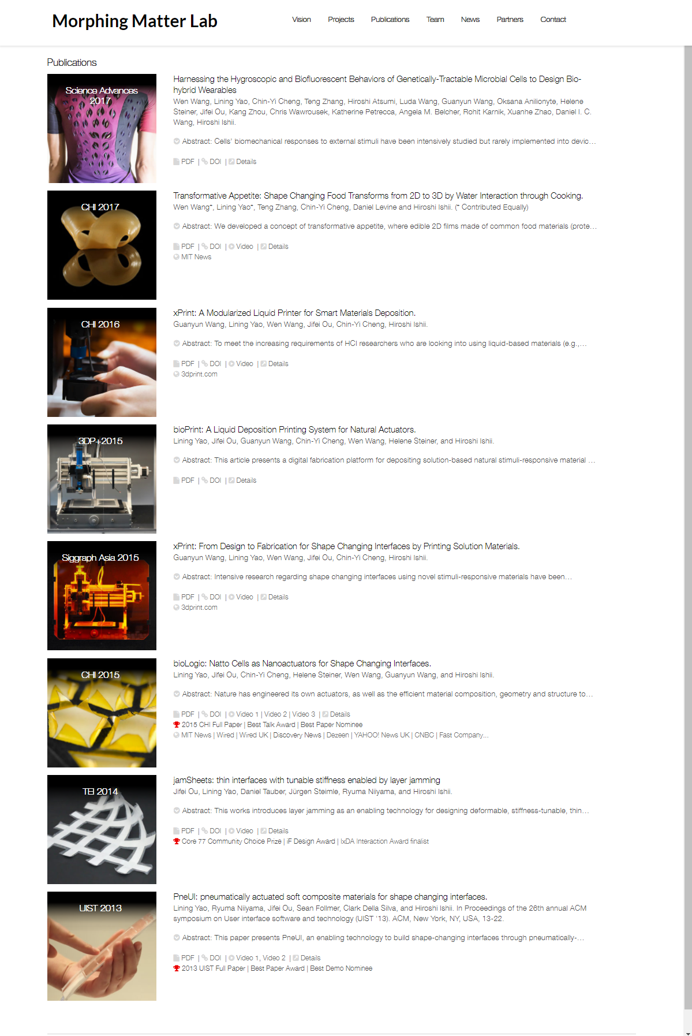
Notes:
http://morphingmatter.cs.cmu.edu/publications/

Slide 24
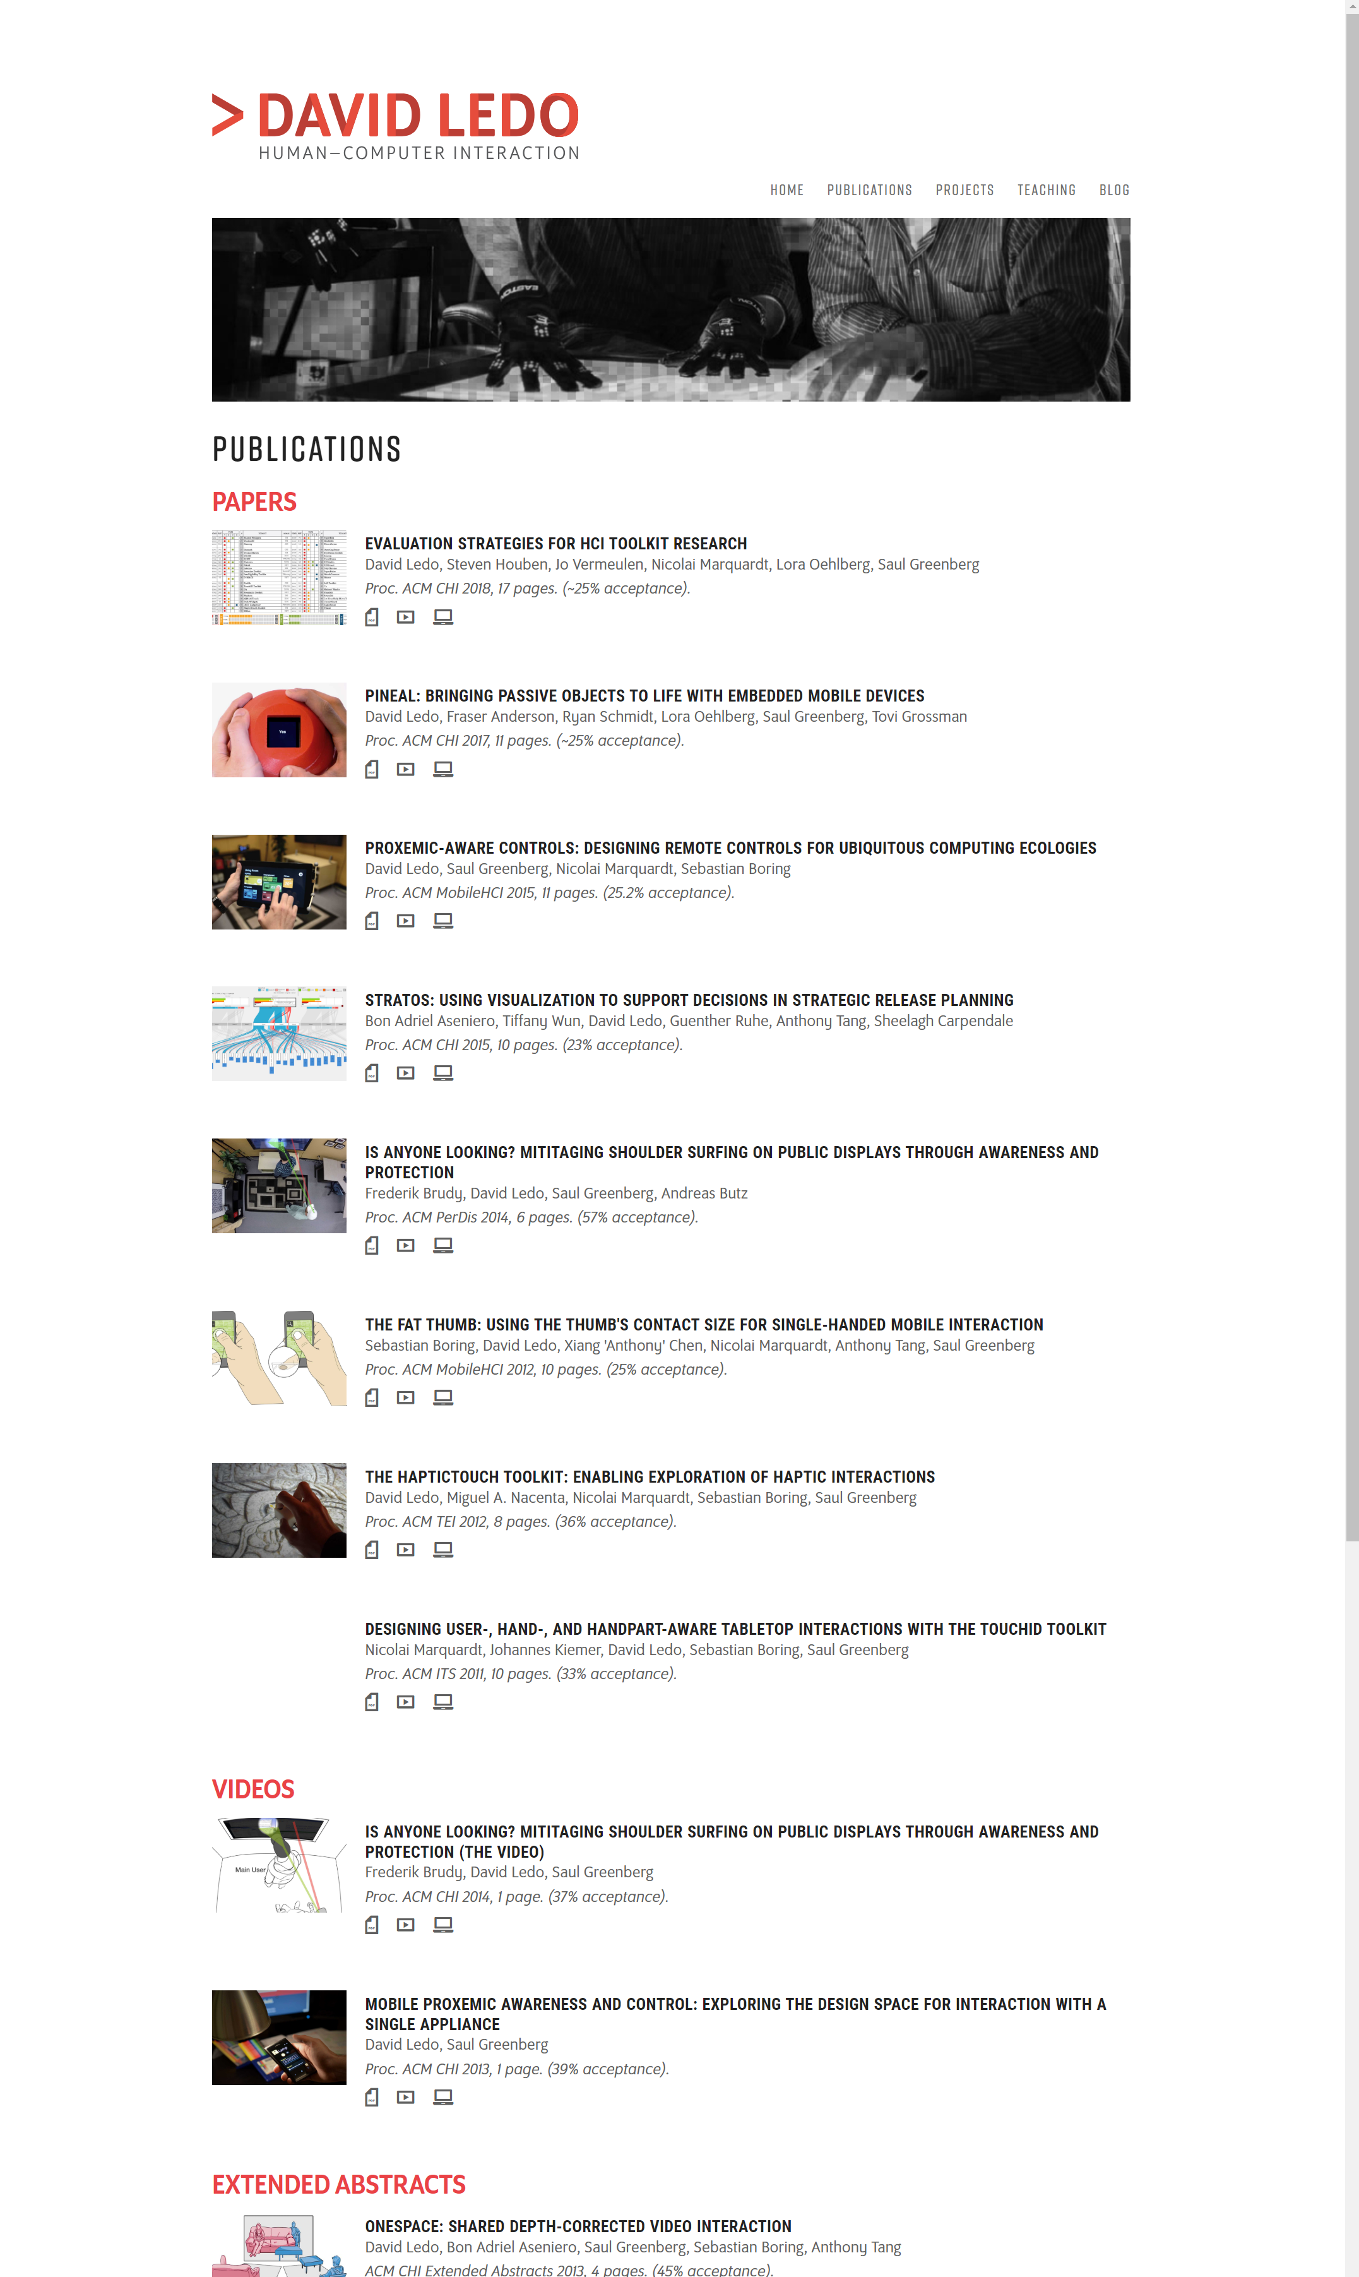
Notes:
http://davidledo.com/publications.html

Slide 25
Individual Person Pages

Slide 26
People Listings

Slide 27
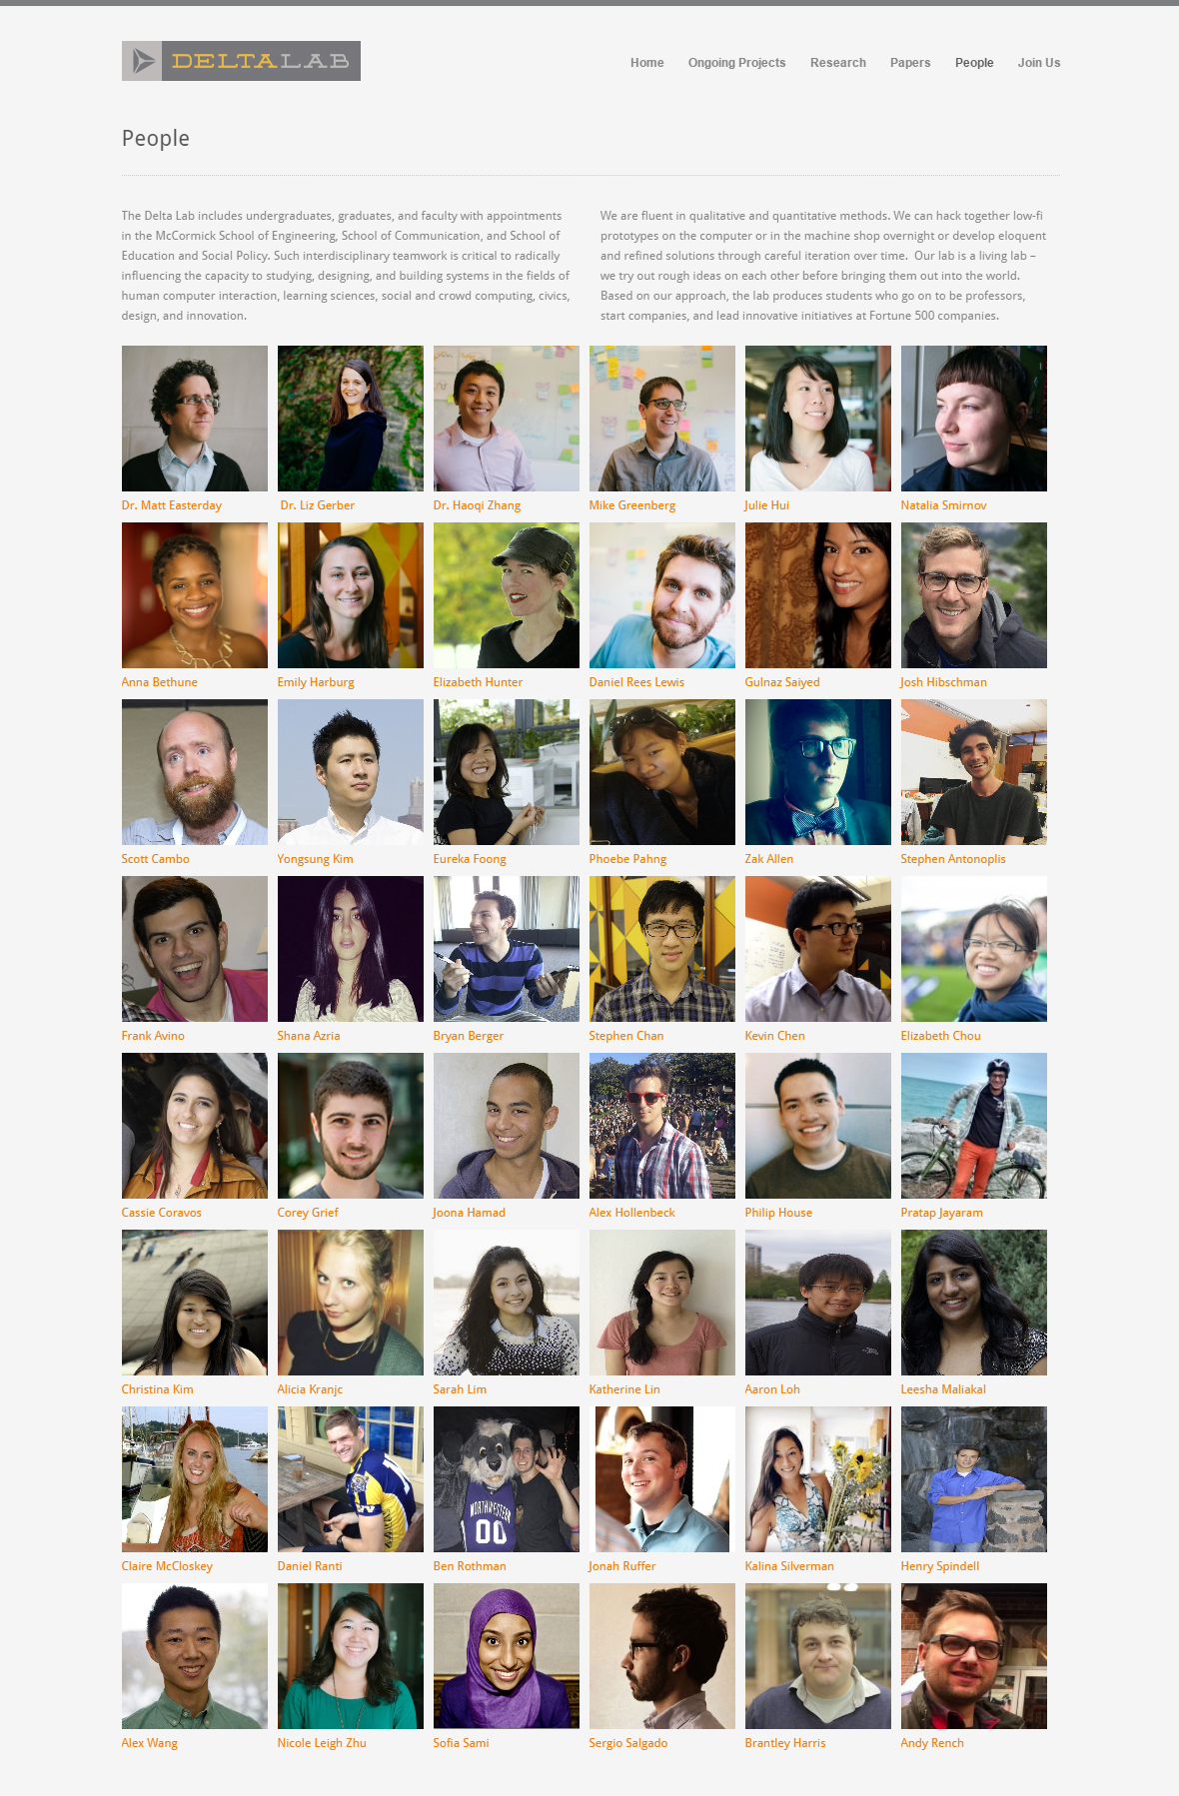
Notes:
http://delta.northwestern.edu/people/

Slide 28
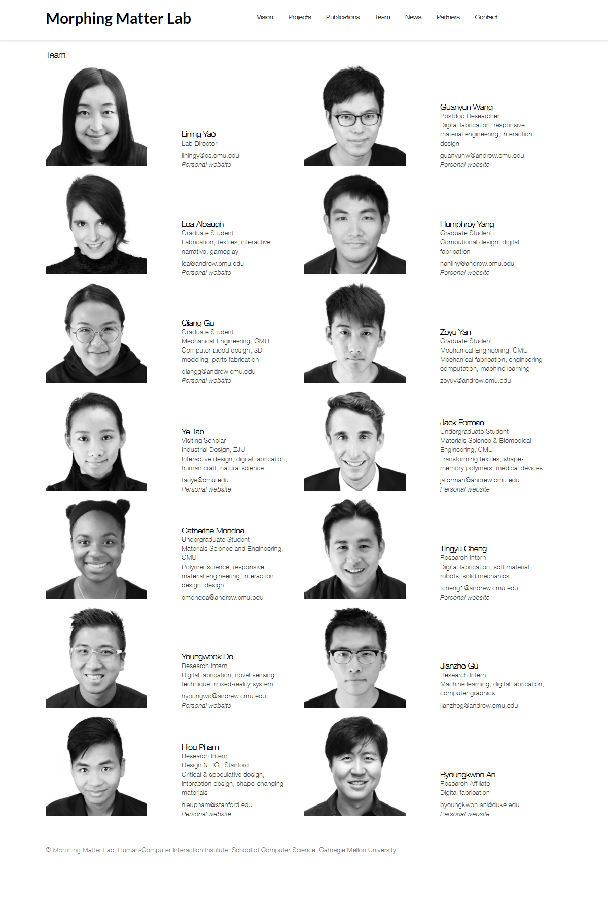
Notes:
http://morphingmatter.cs.cmu.edu/team/

Slide 29
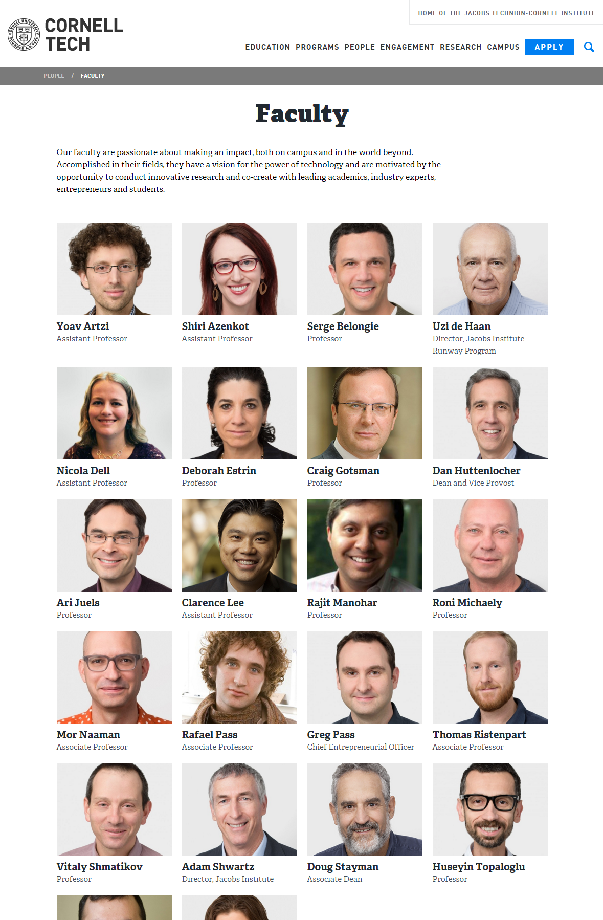
Notes:
http://tech.cornell.edu/people/faculty

Slide 30
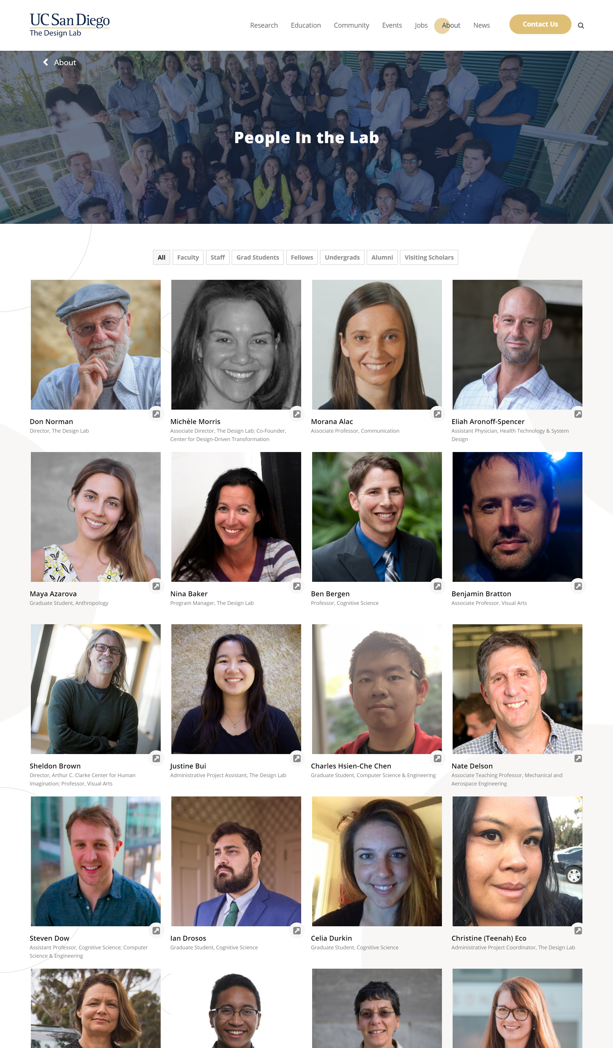

Slide 31
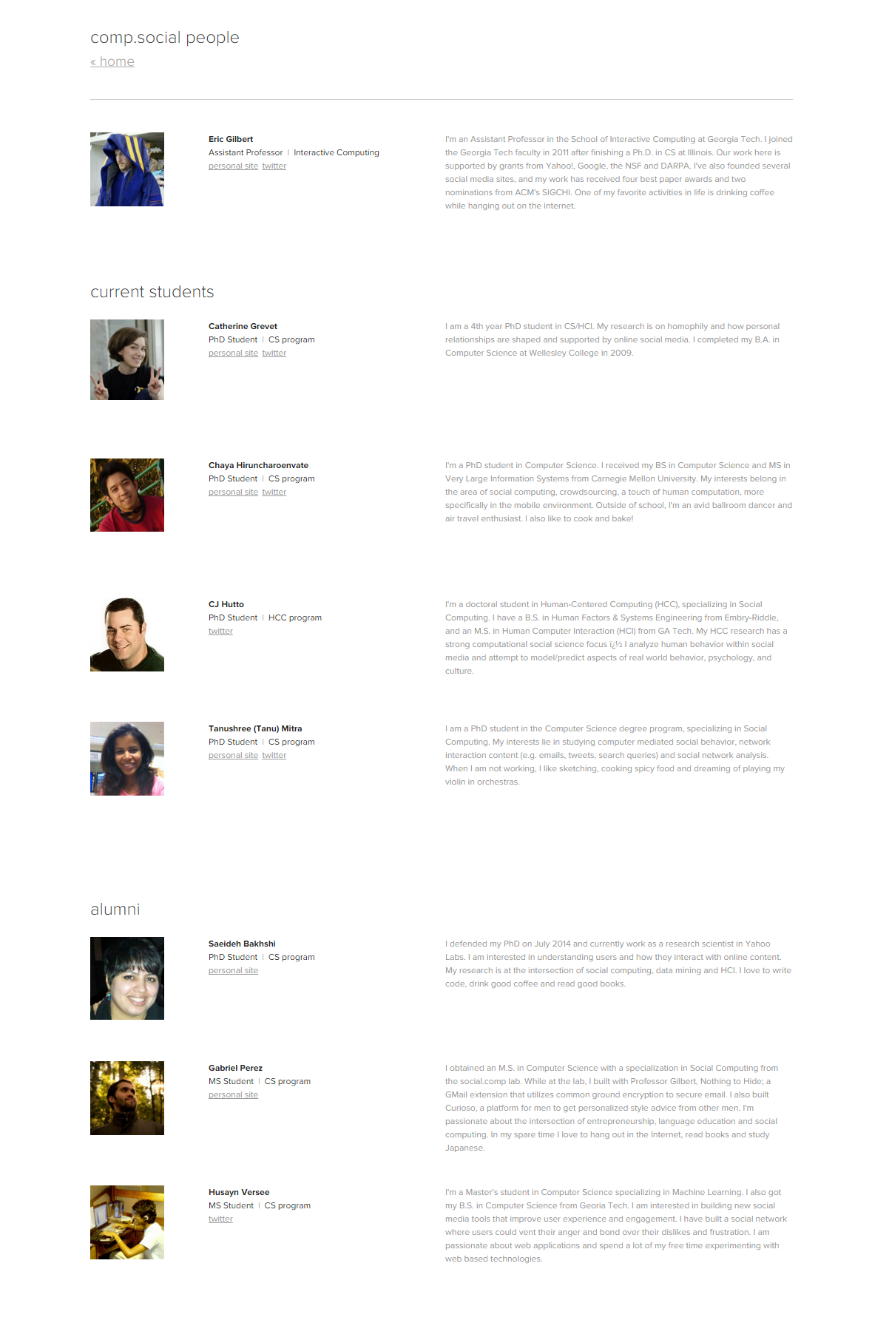

Slide 32
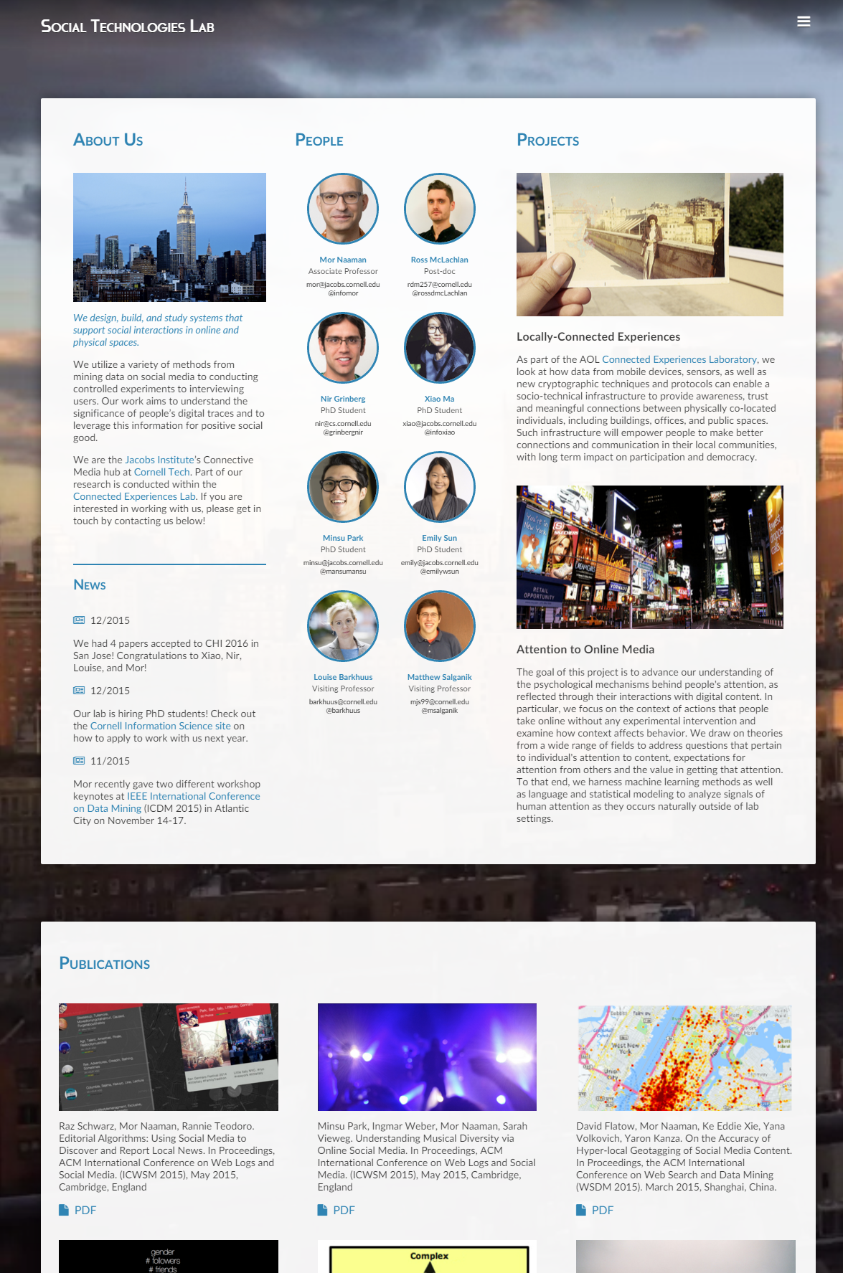
Notes:
https://s.tech.cornell.edu/

Slide 33
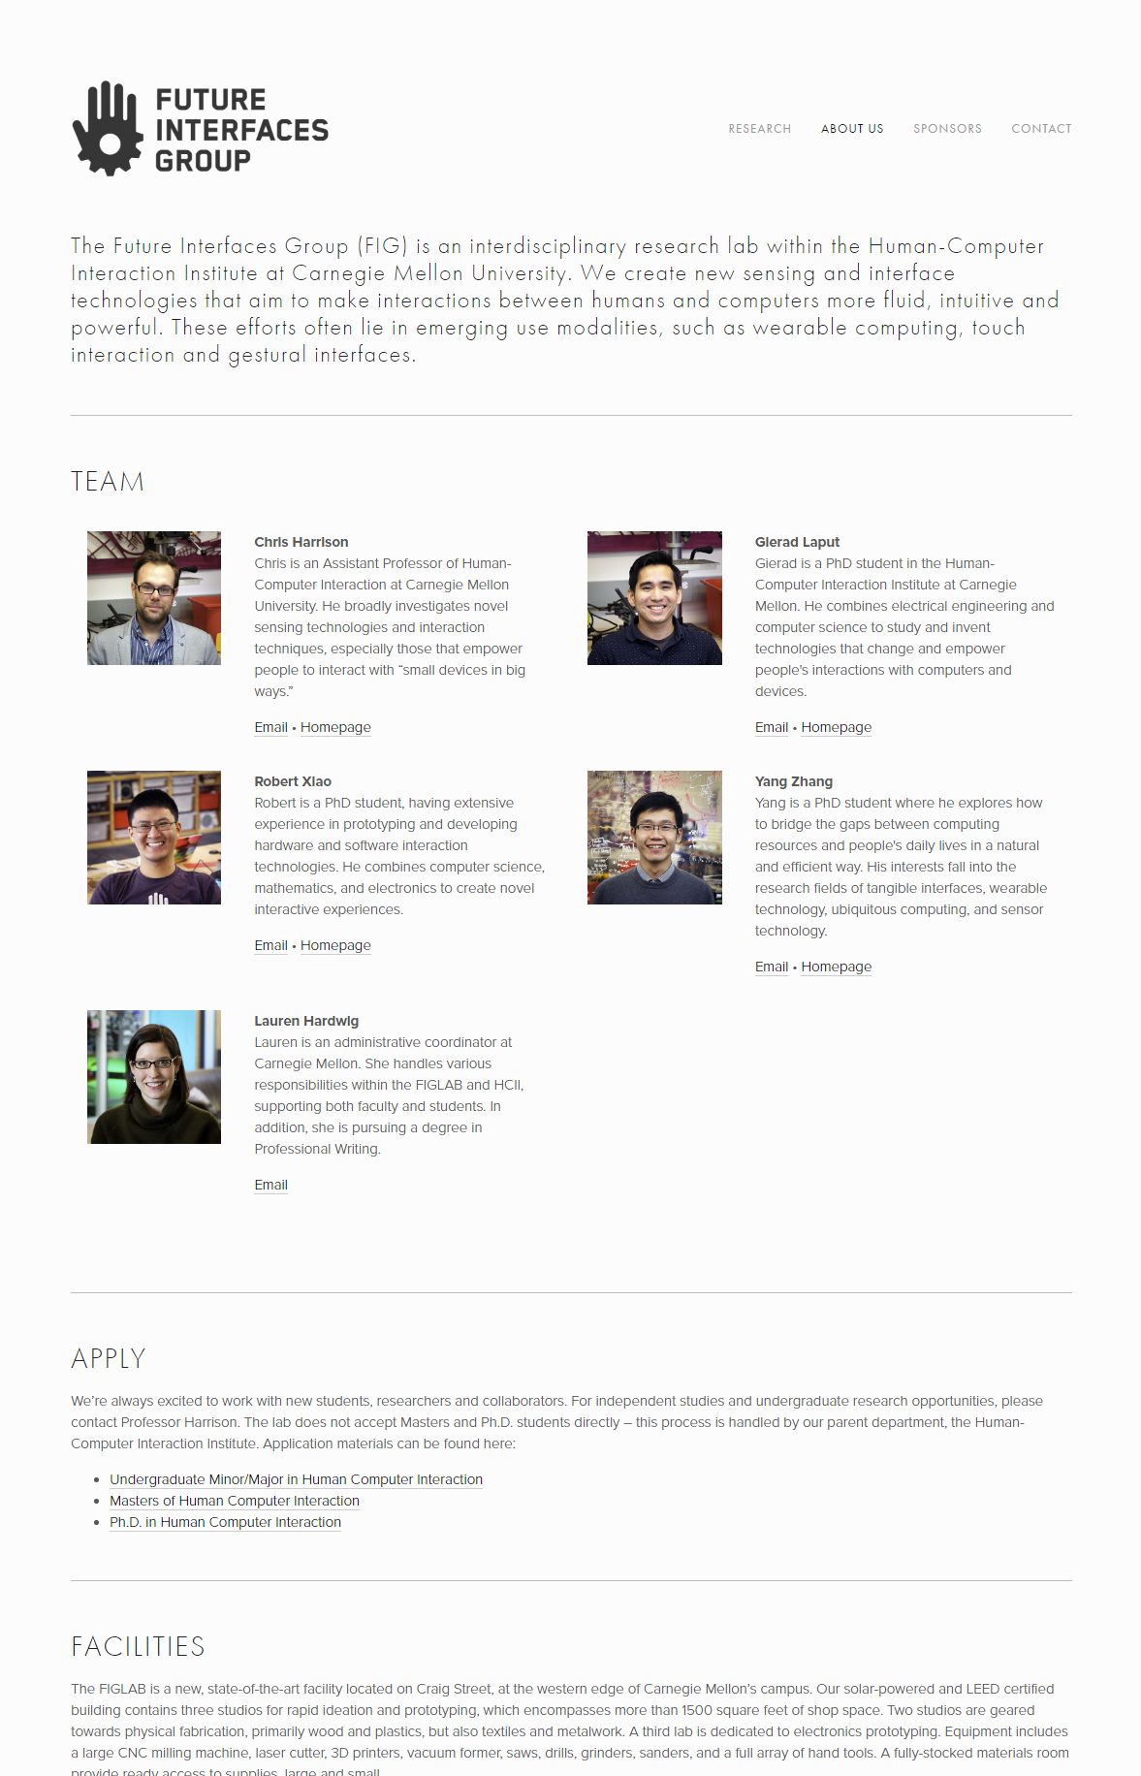
Notes:
http://www.figlab.com/about-us/

Slide 34
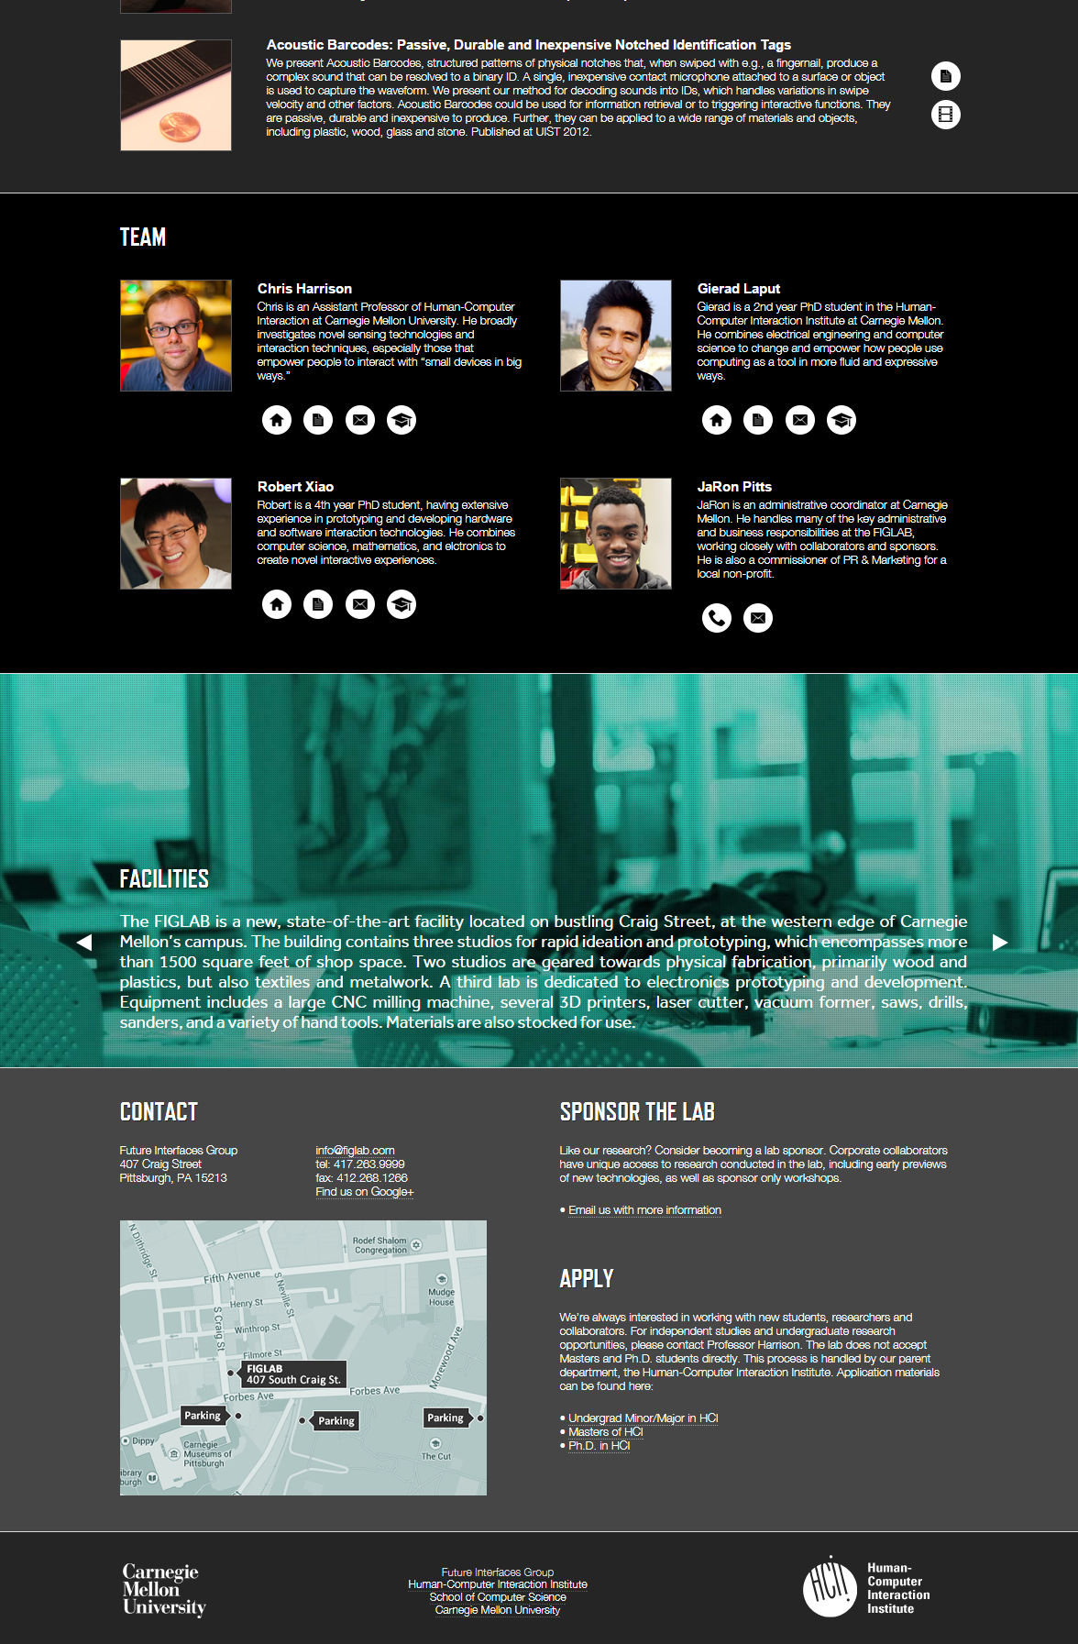

Slide 35
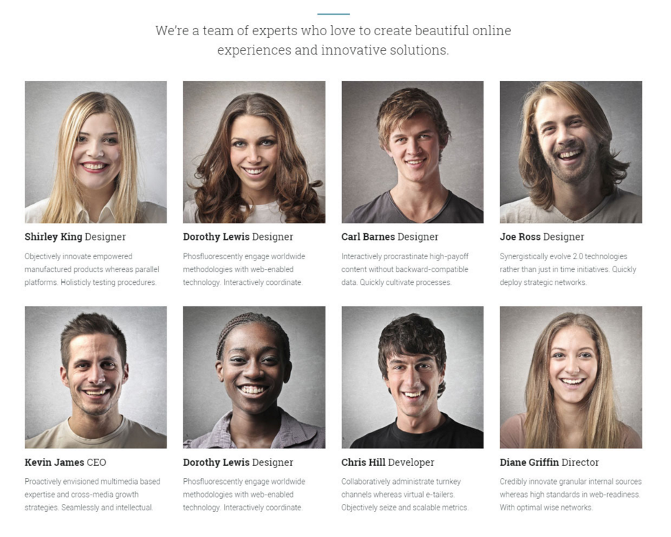
Notes:
From Lambda template here: http://www.responsivemiracle.com/collective/best-responsive-portfolio-html5-templates-2015/
Direct link: http://lambdahtml.oxygenna.com/corporate-meet-the-team.html
Font family: Raleway, sans-serif

Slide 36
Project Galleries

Slide 37
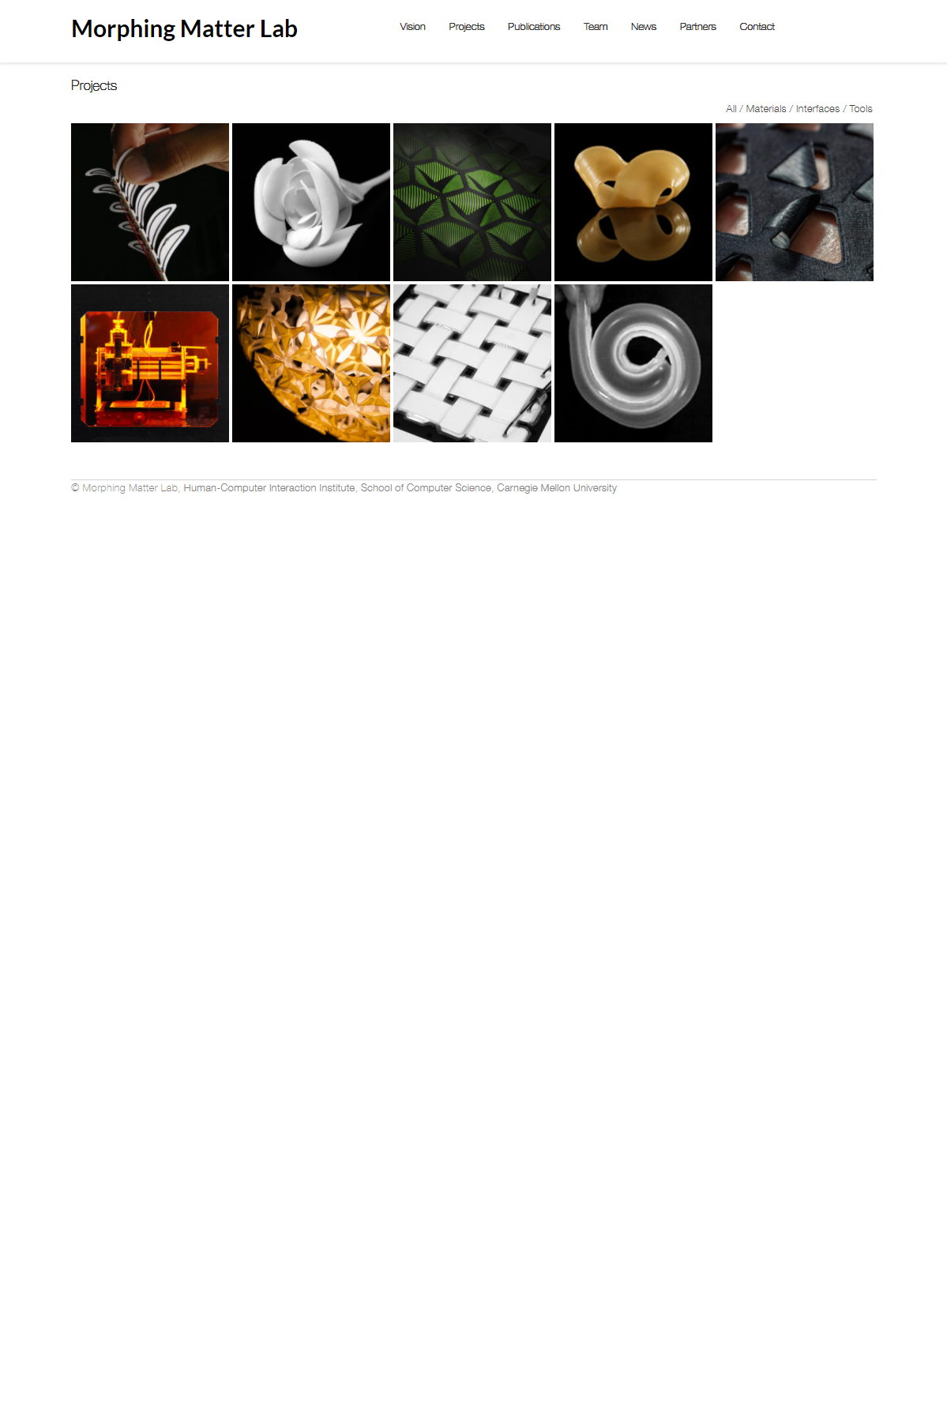

Slide 38
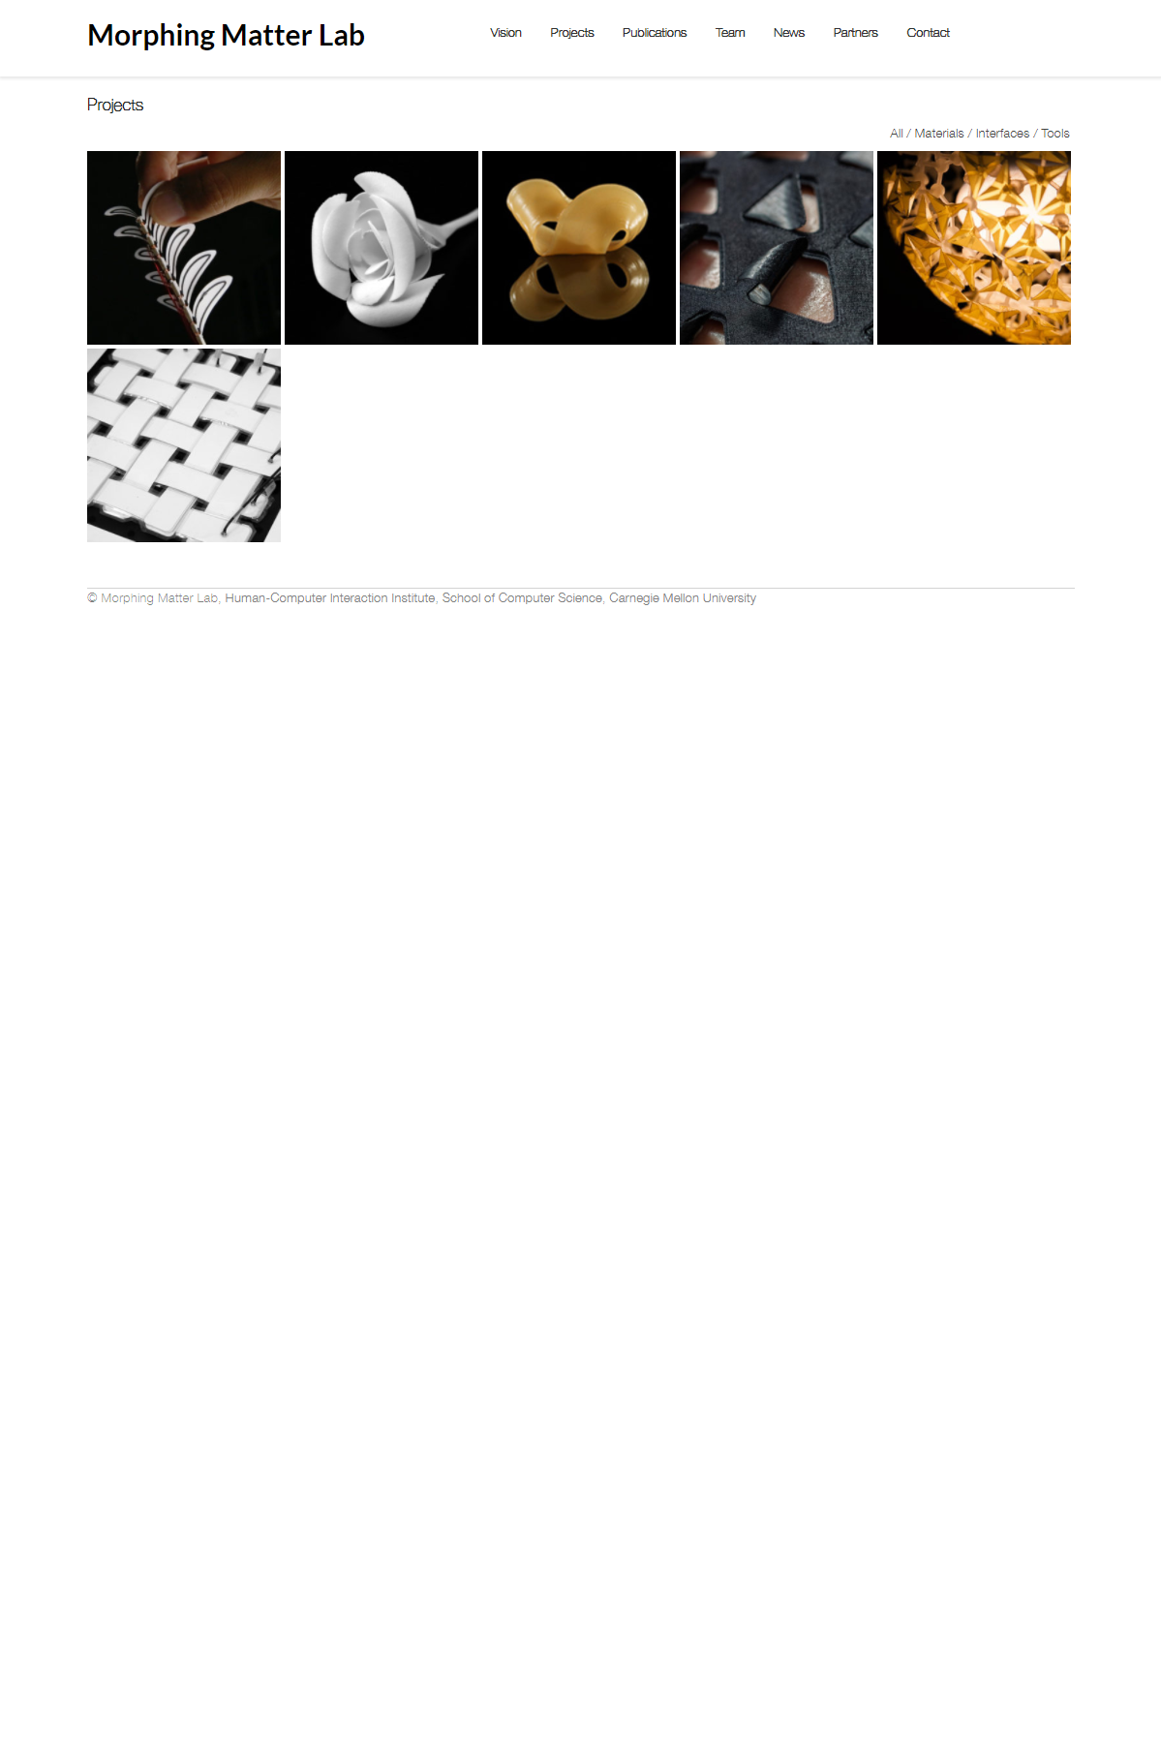
Notes:
http://morphingmatter.cs.cmu.edu/projects/

Slide 39
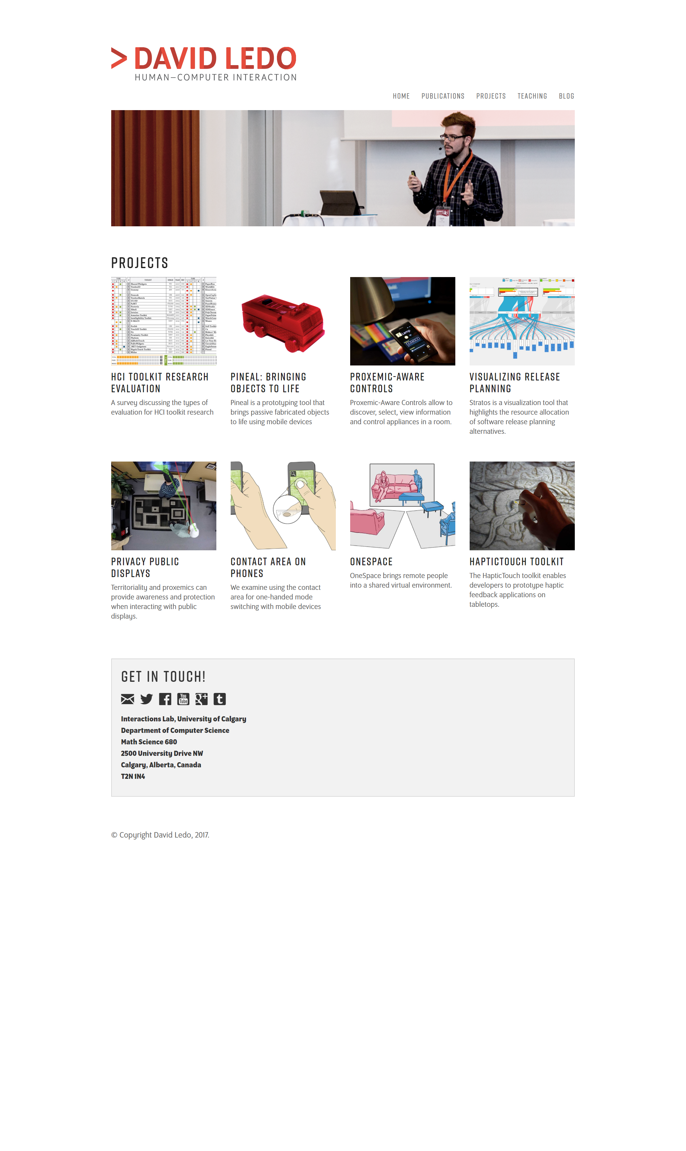

Slide 40
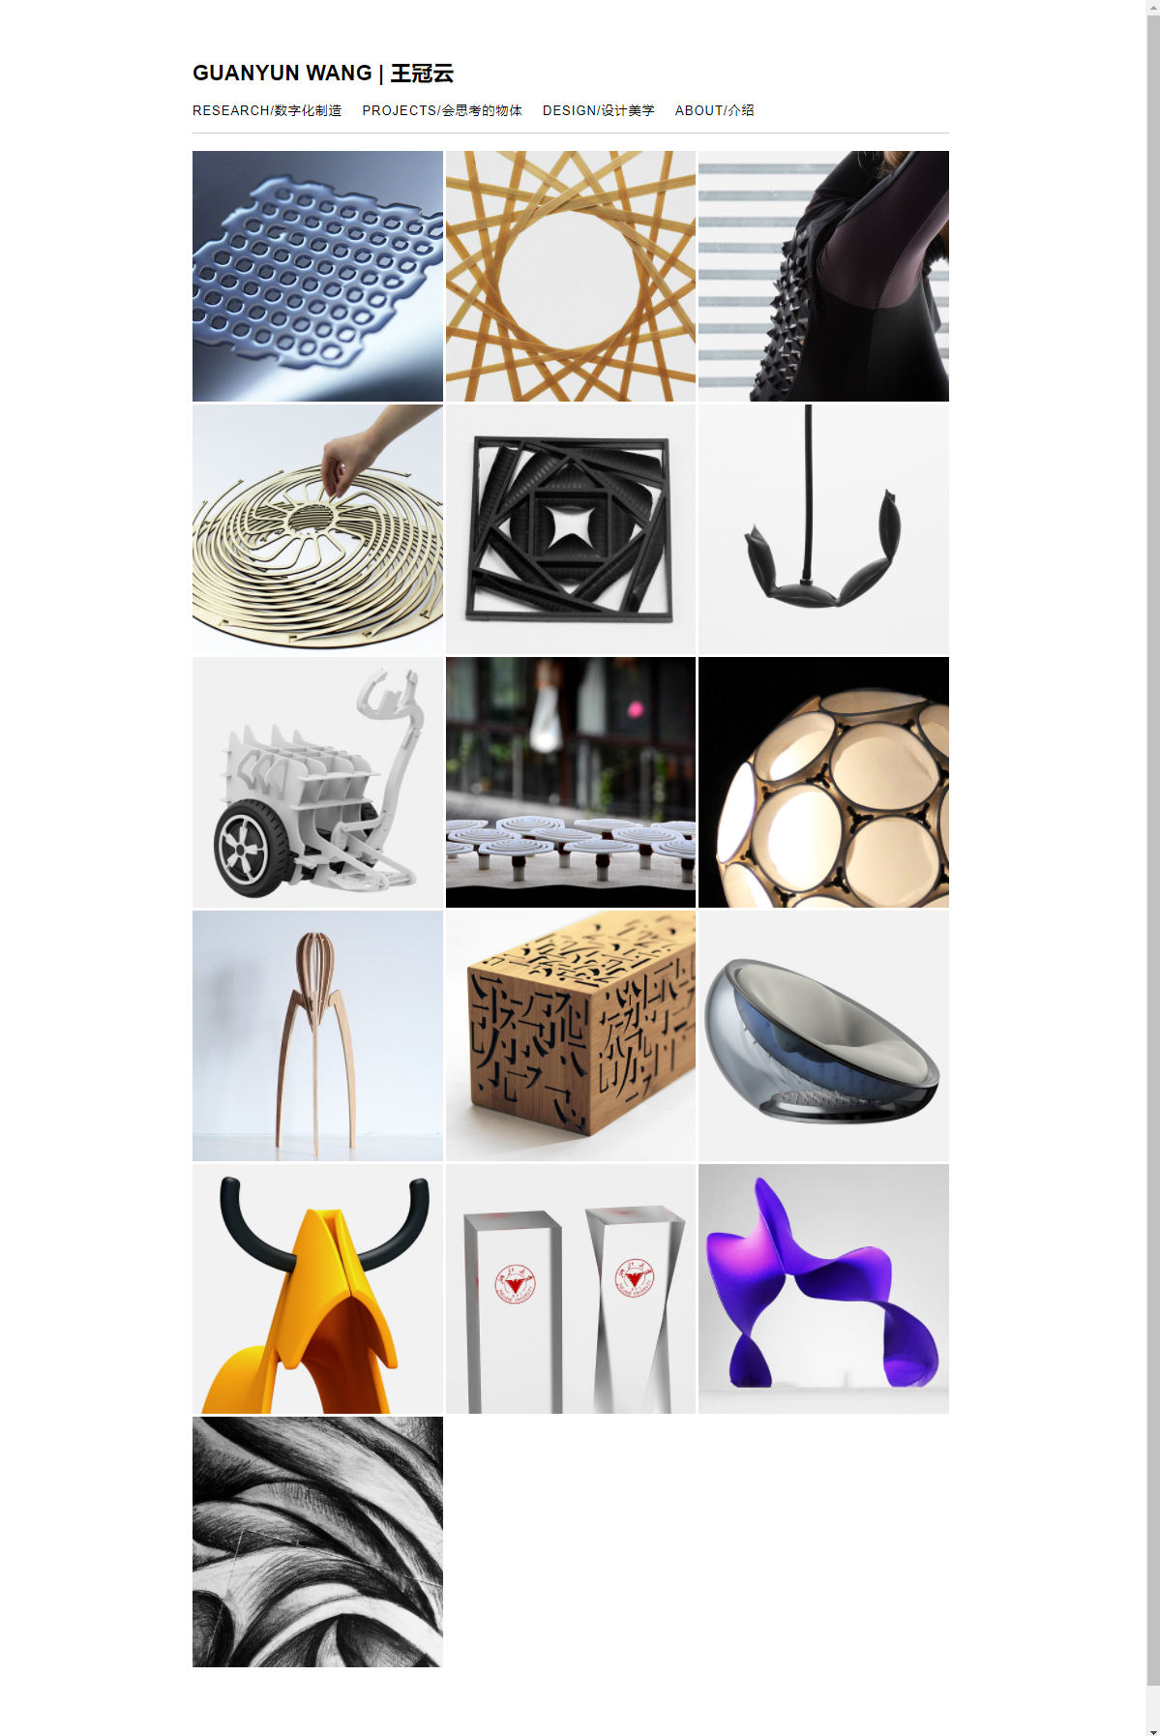
Notes:
http://guanyundesign.com/

Slide 41
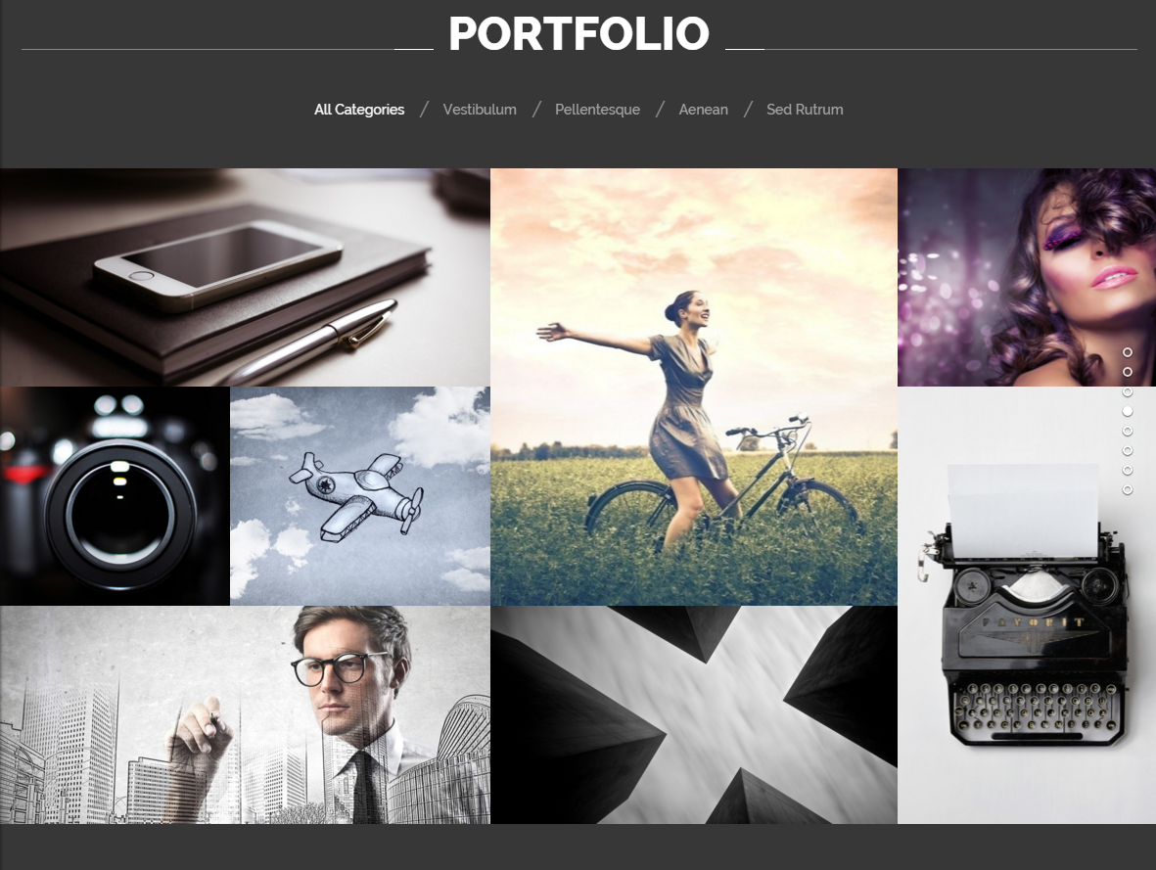
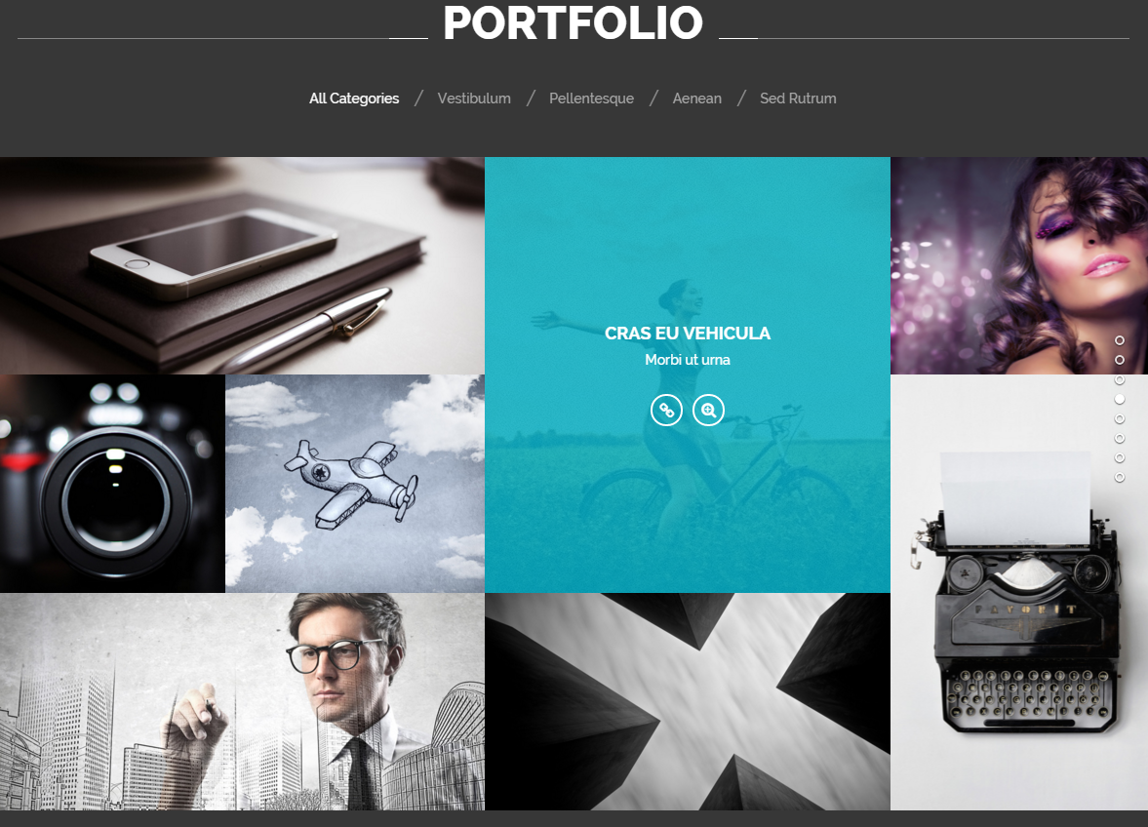

Slide 42
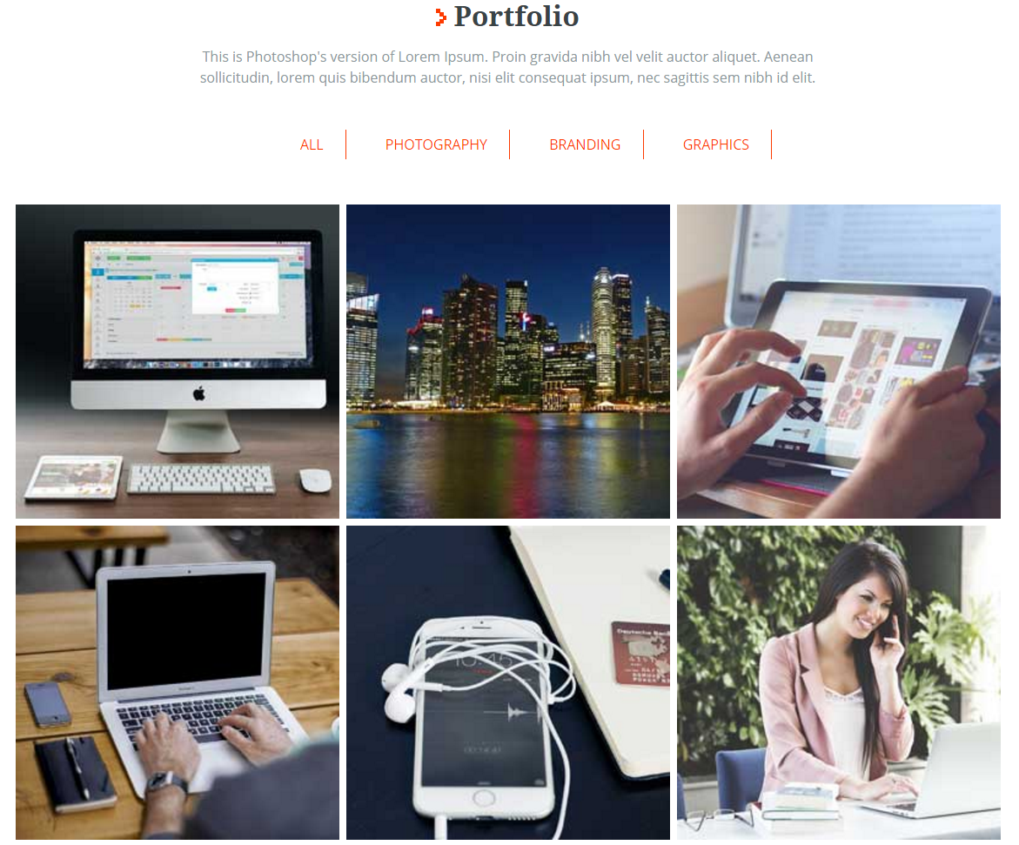
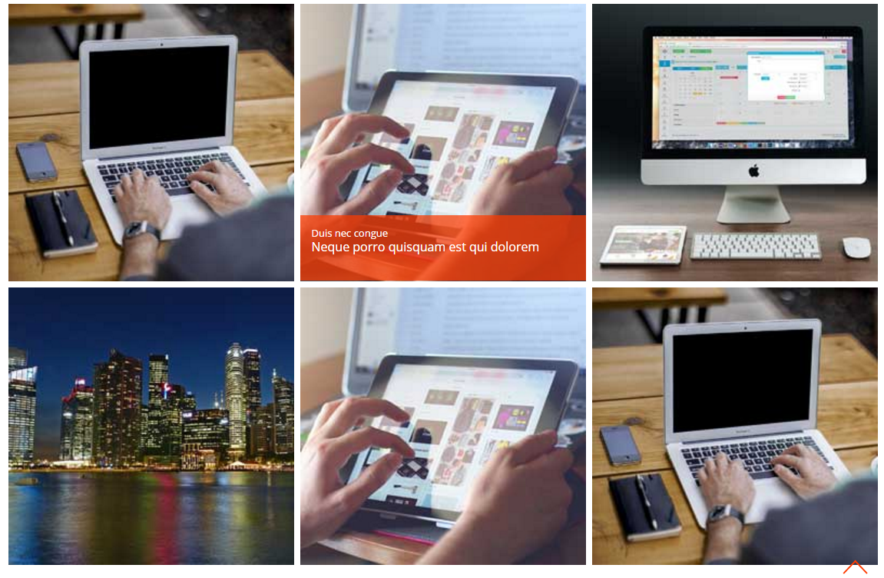

Slide 43
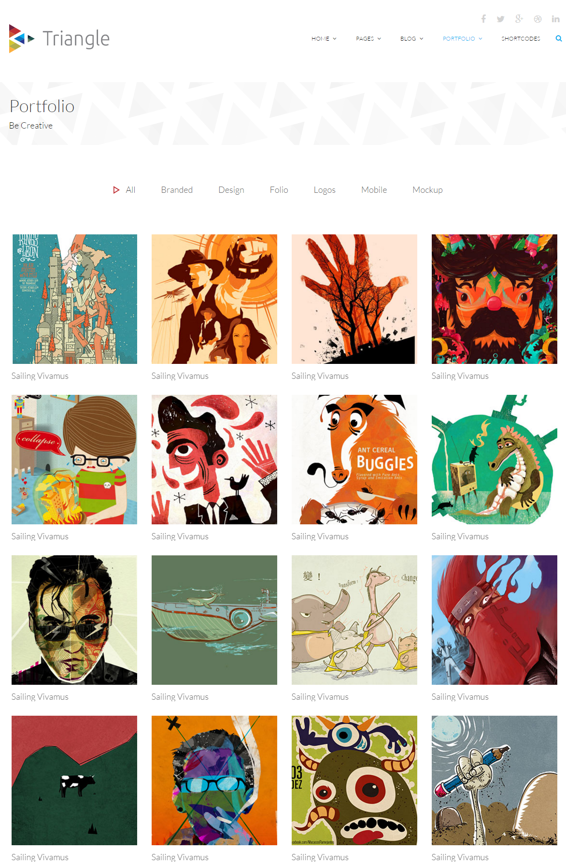
Notes:
Grid is completely responsive: http://demo.themeum.com/html/triangle/1.1/portfolio.html
Font-family: ‘Lato’, sans-serif

Slide 44
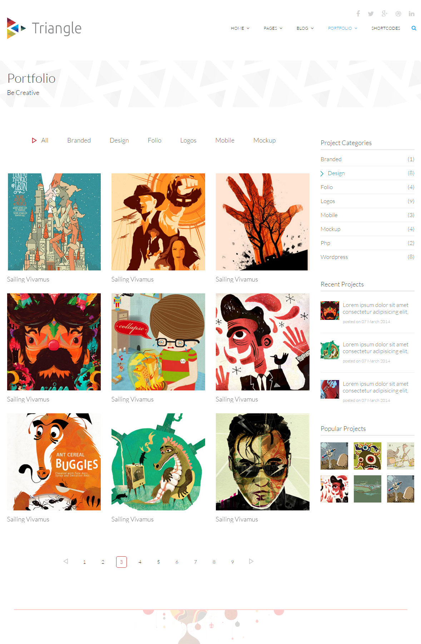
Notes:
http://demo.themeum.com/html/triangle/1.1/portfolio.html

Slide 45
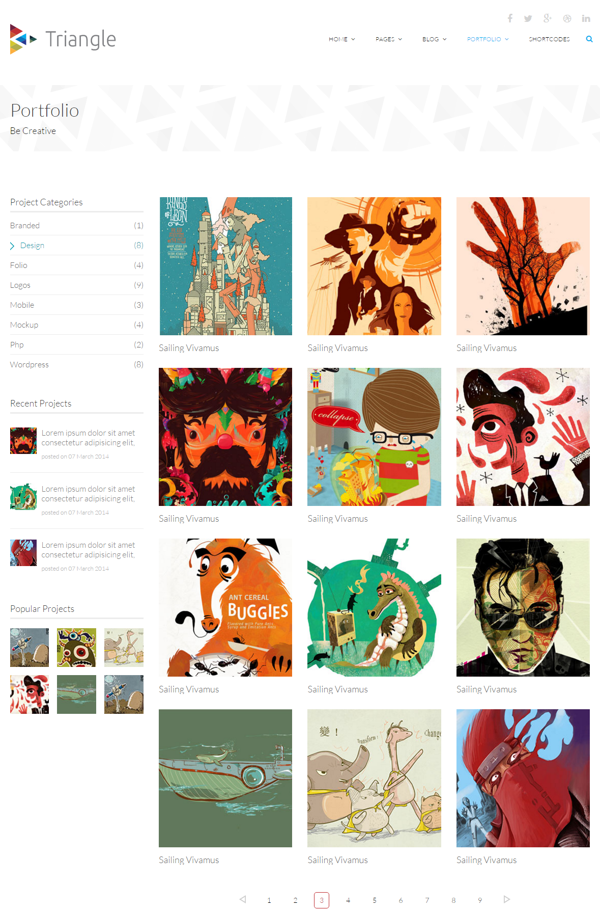
Notes:
http://demo.themeum.com/html/triangle/1.1/portfoliotwo.html

Slide 46
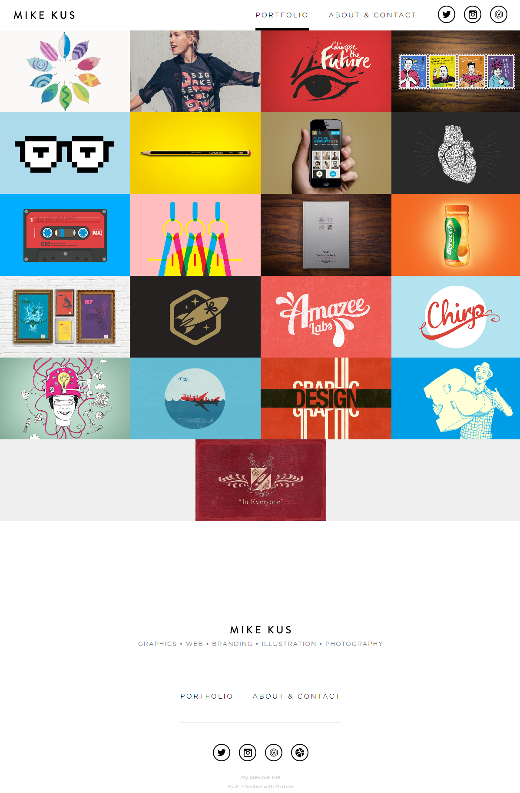
Notes:
http://mikekus.com/

Slide 47
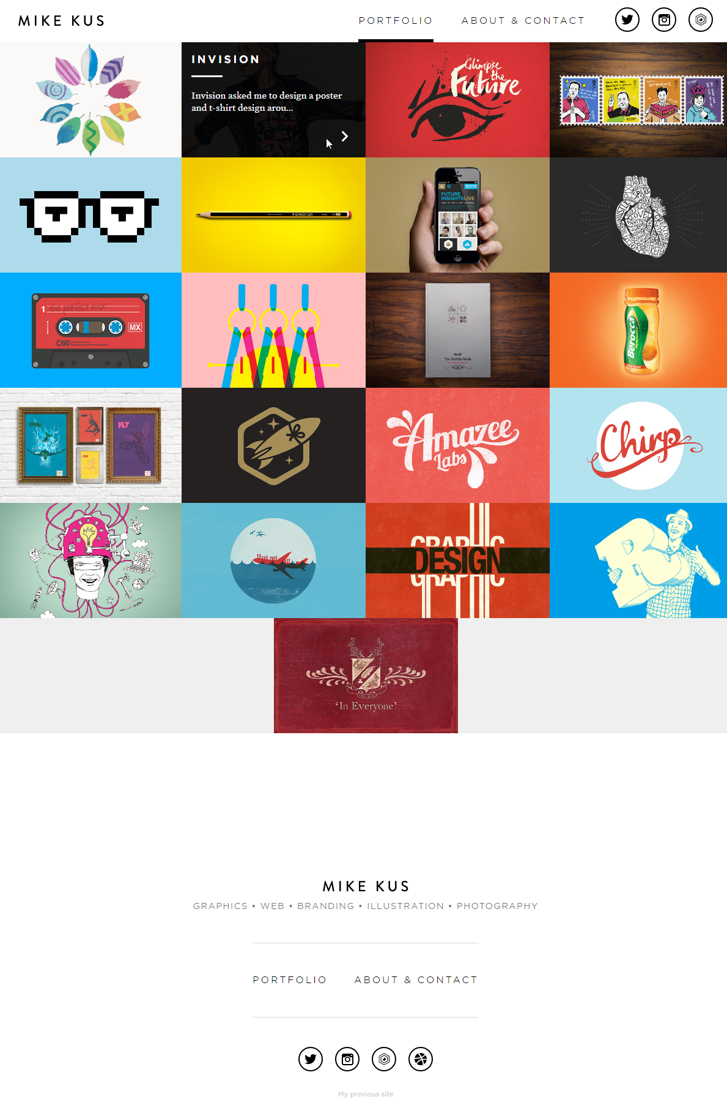
Notes:
http://mikekus.com/

Slide 48
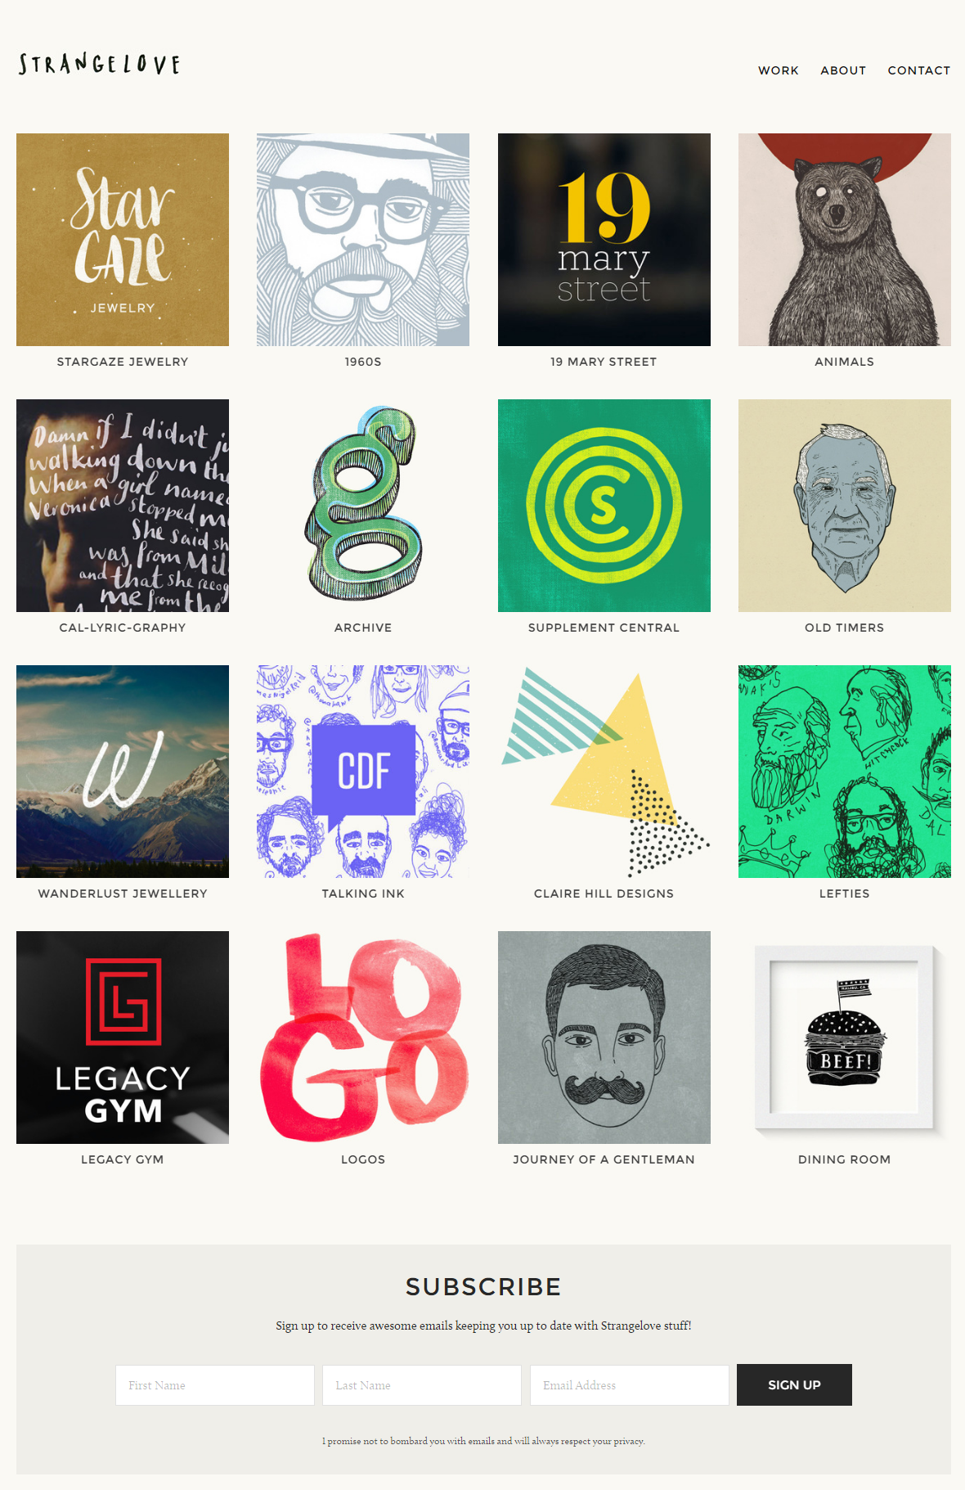
Notes:
http://www.strangelove.me/

Slide 49
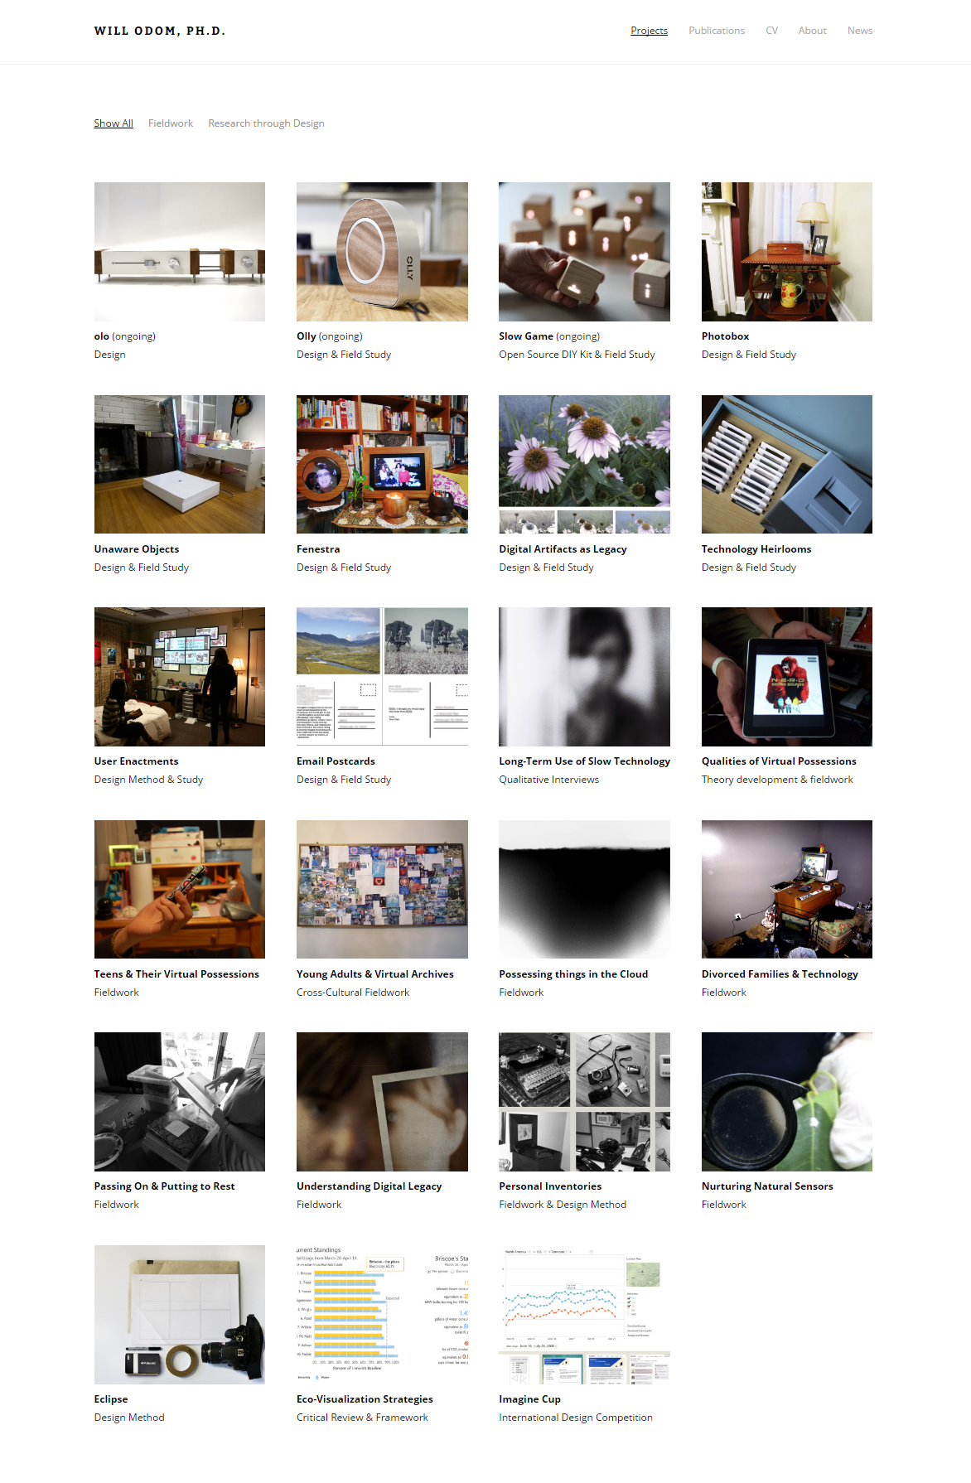
Notes:
http://willodom.com/portfolio/

Slide 50
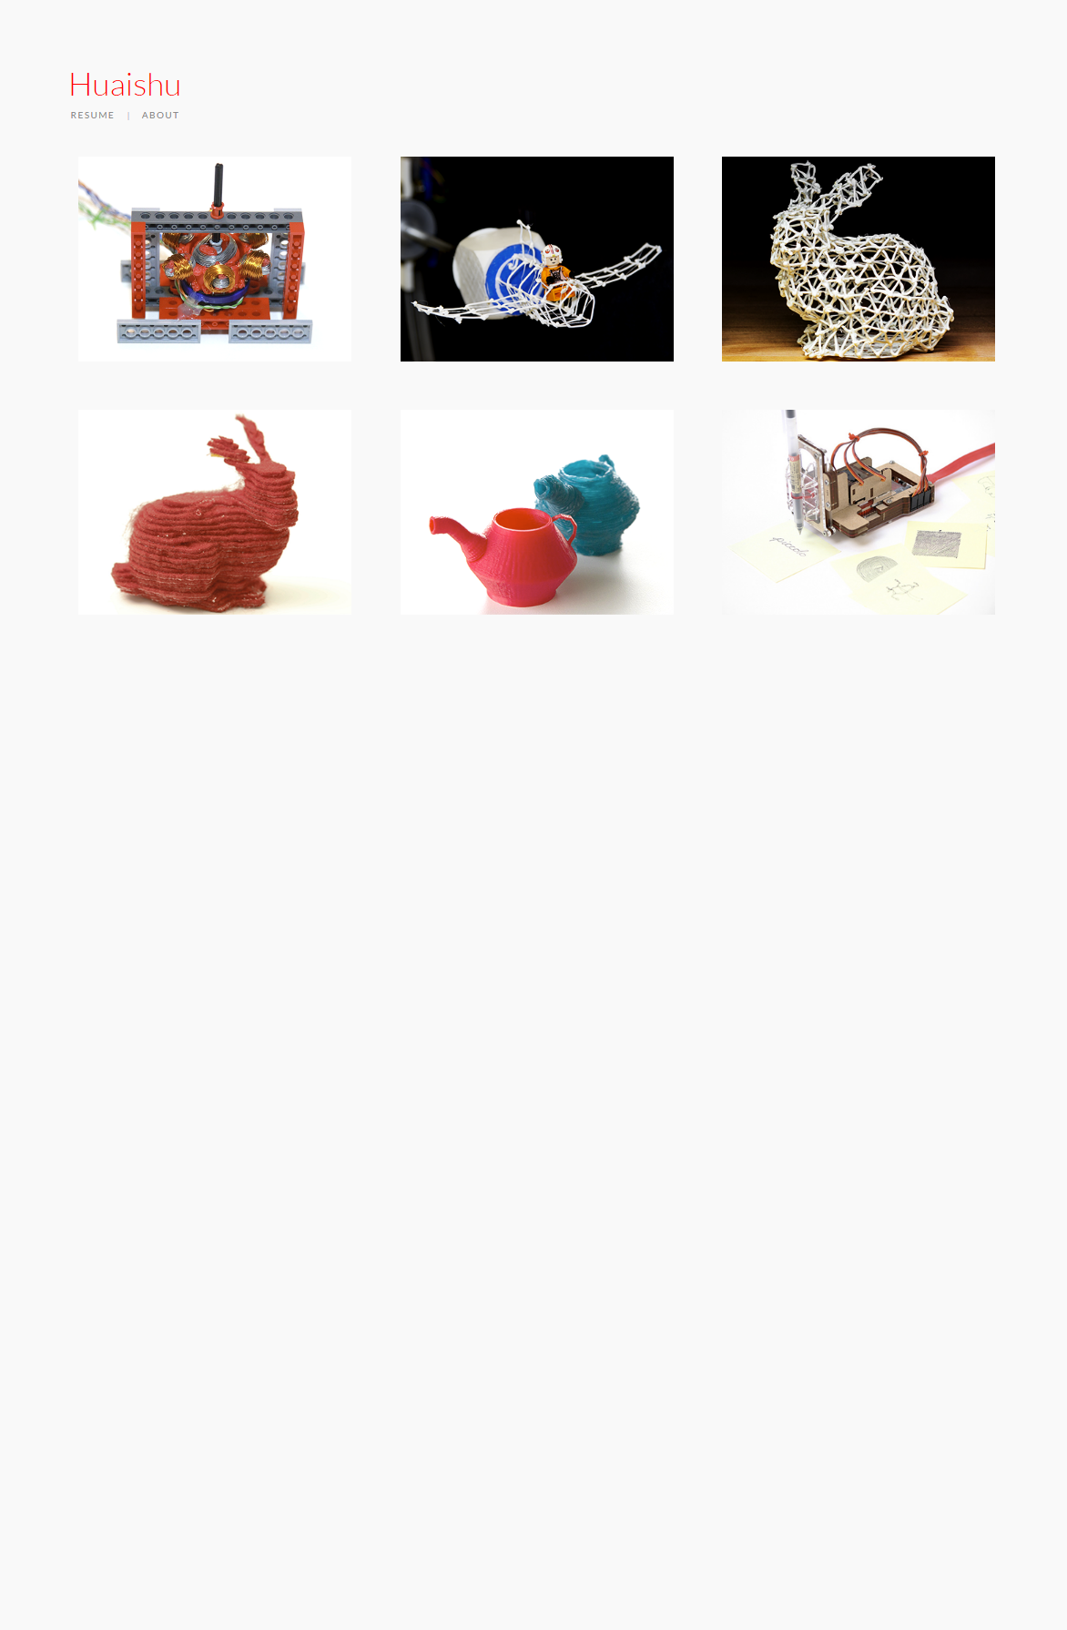

Slide 51
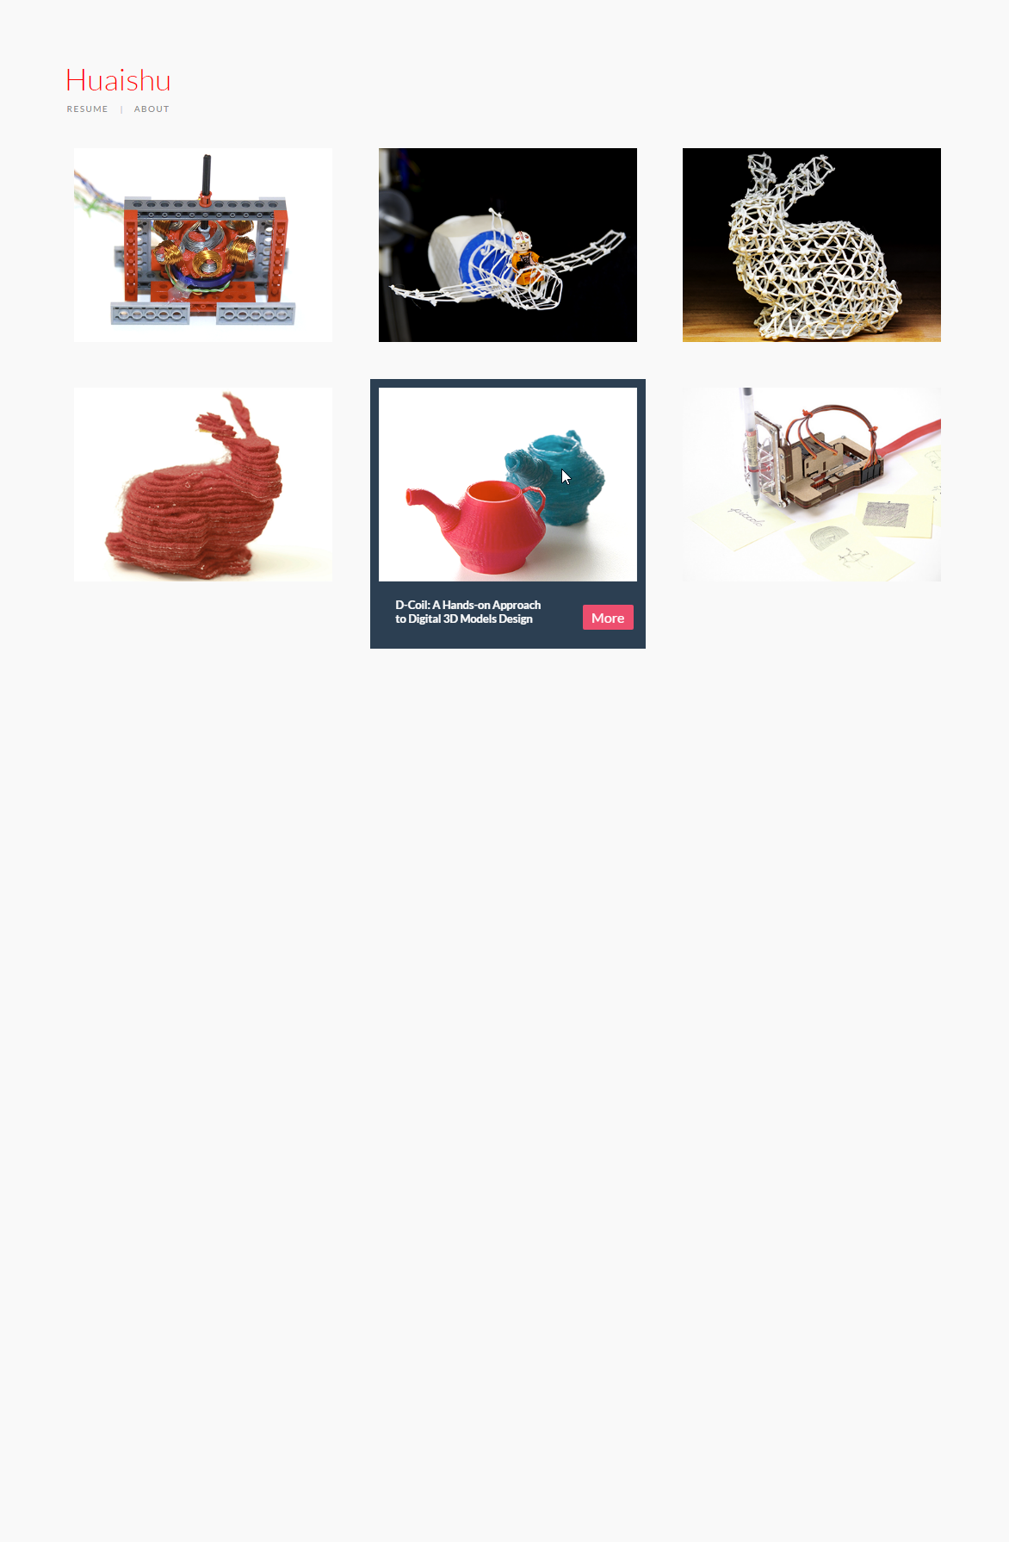

Slide 52
Notes:
http://www.figlab.com/

Slide 53
Individual Project Pages

Slide 54
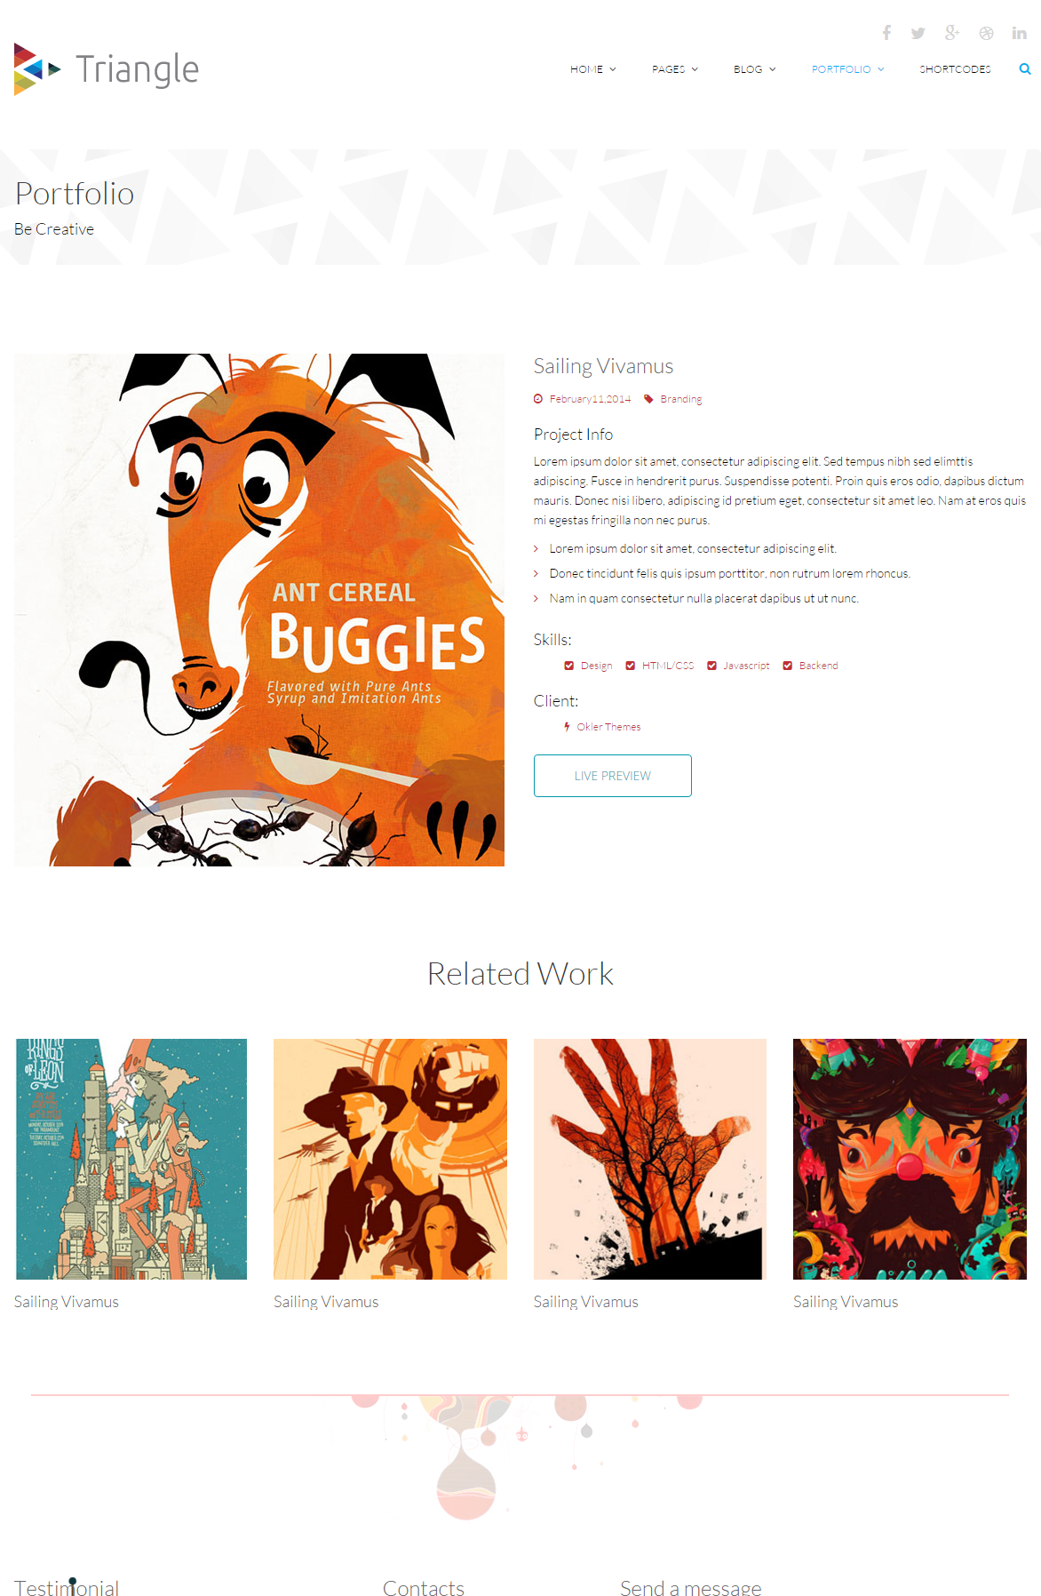

Slide 55
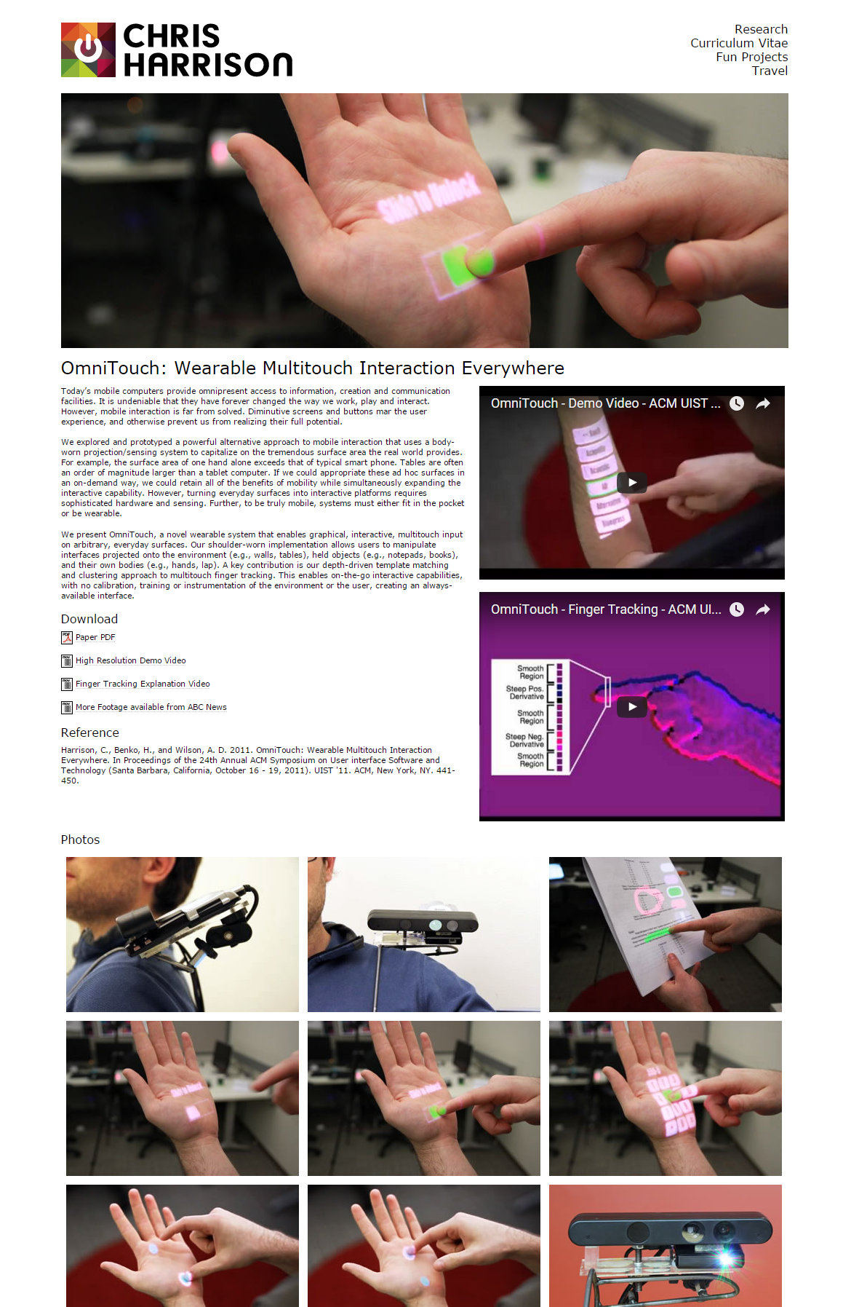
Notes:
http://www.chrisharrison.net/index.php/Research/OmniTouch

Slide 56
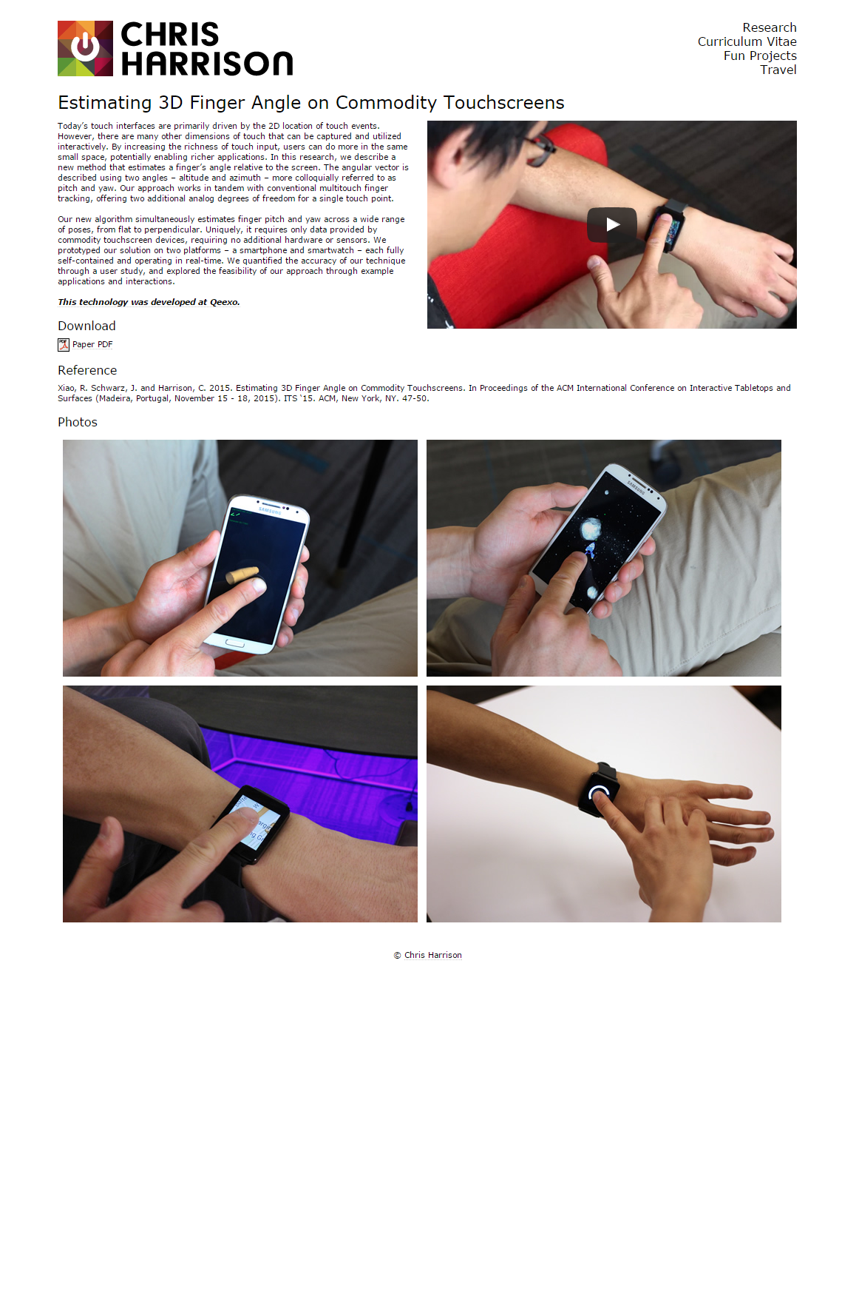
Notes:
http://www.chrisharrison.net/index.php/Research/3DFingerAngle

Slide 57
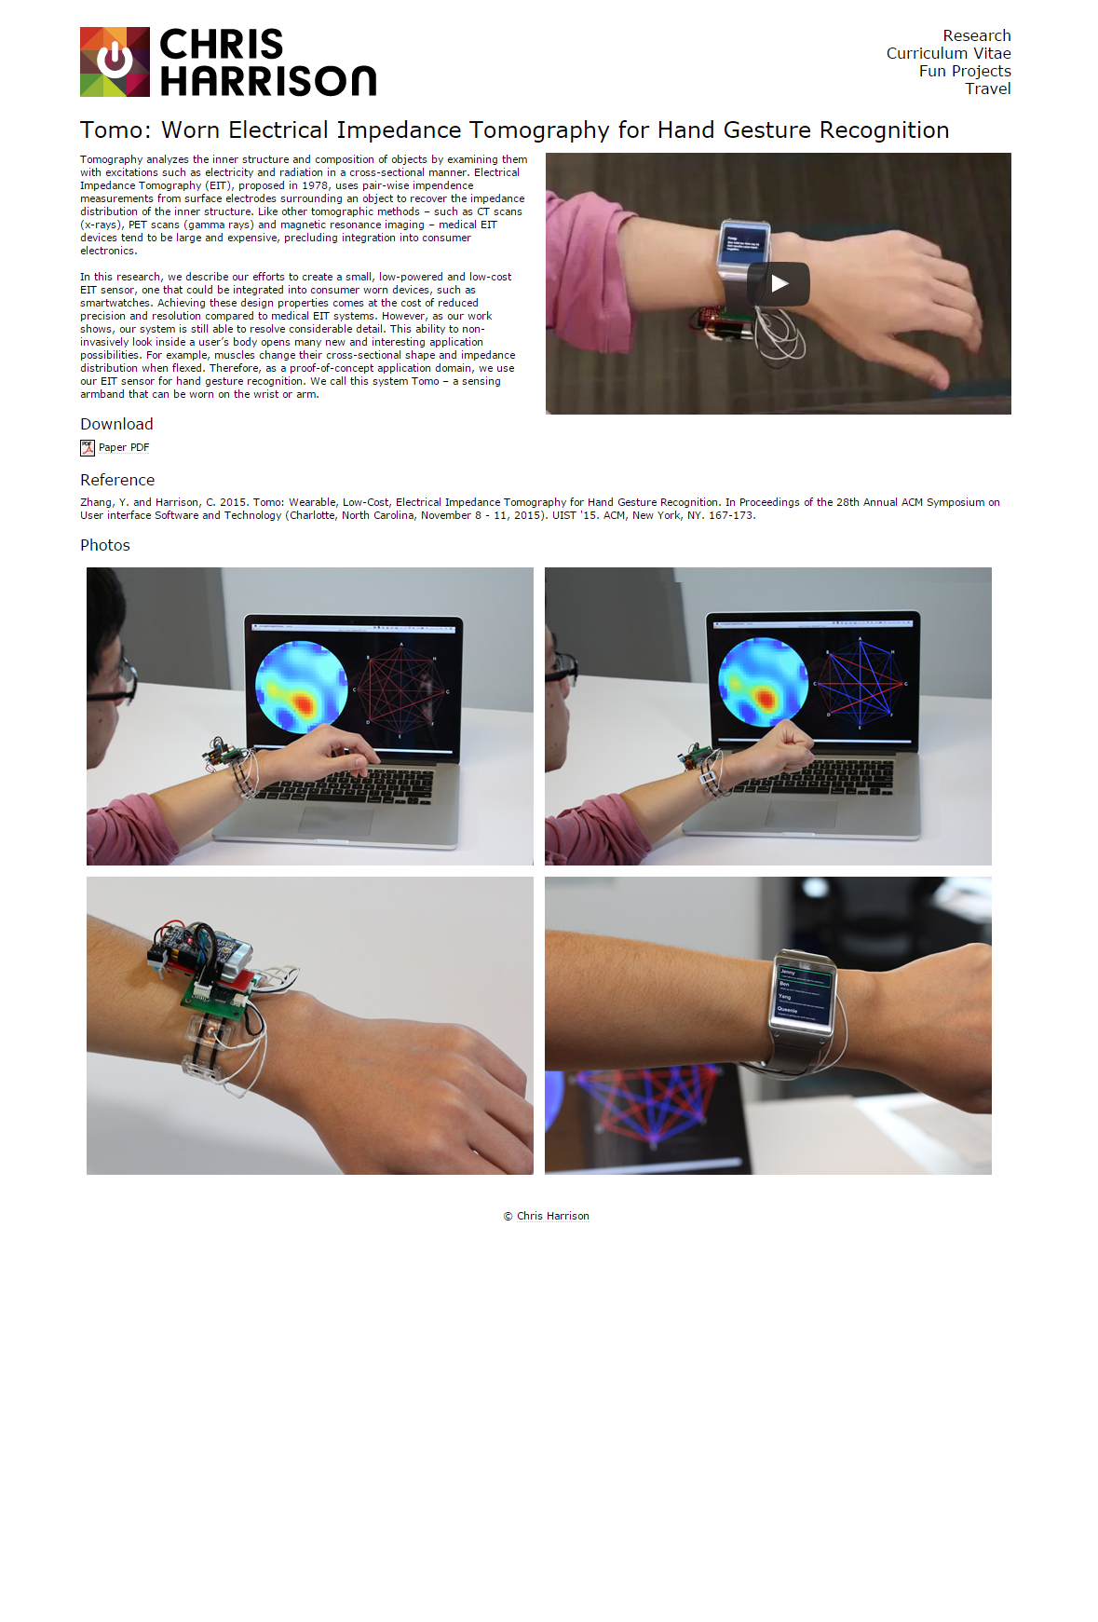

Slide 58
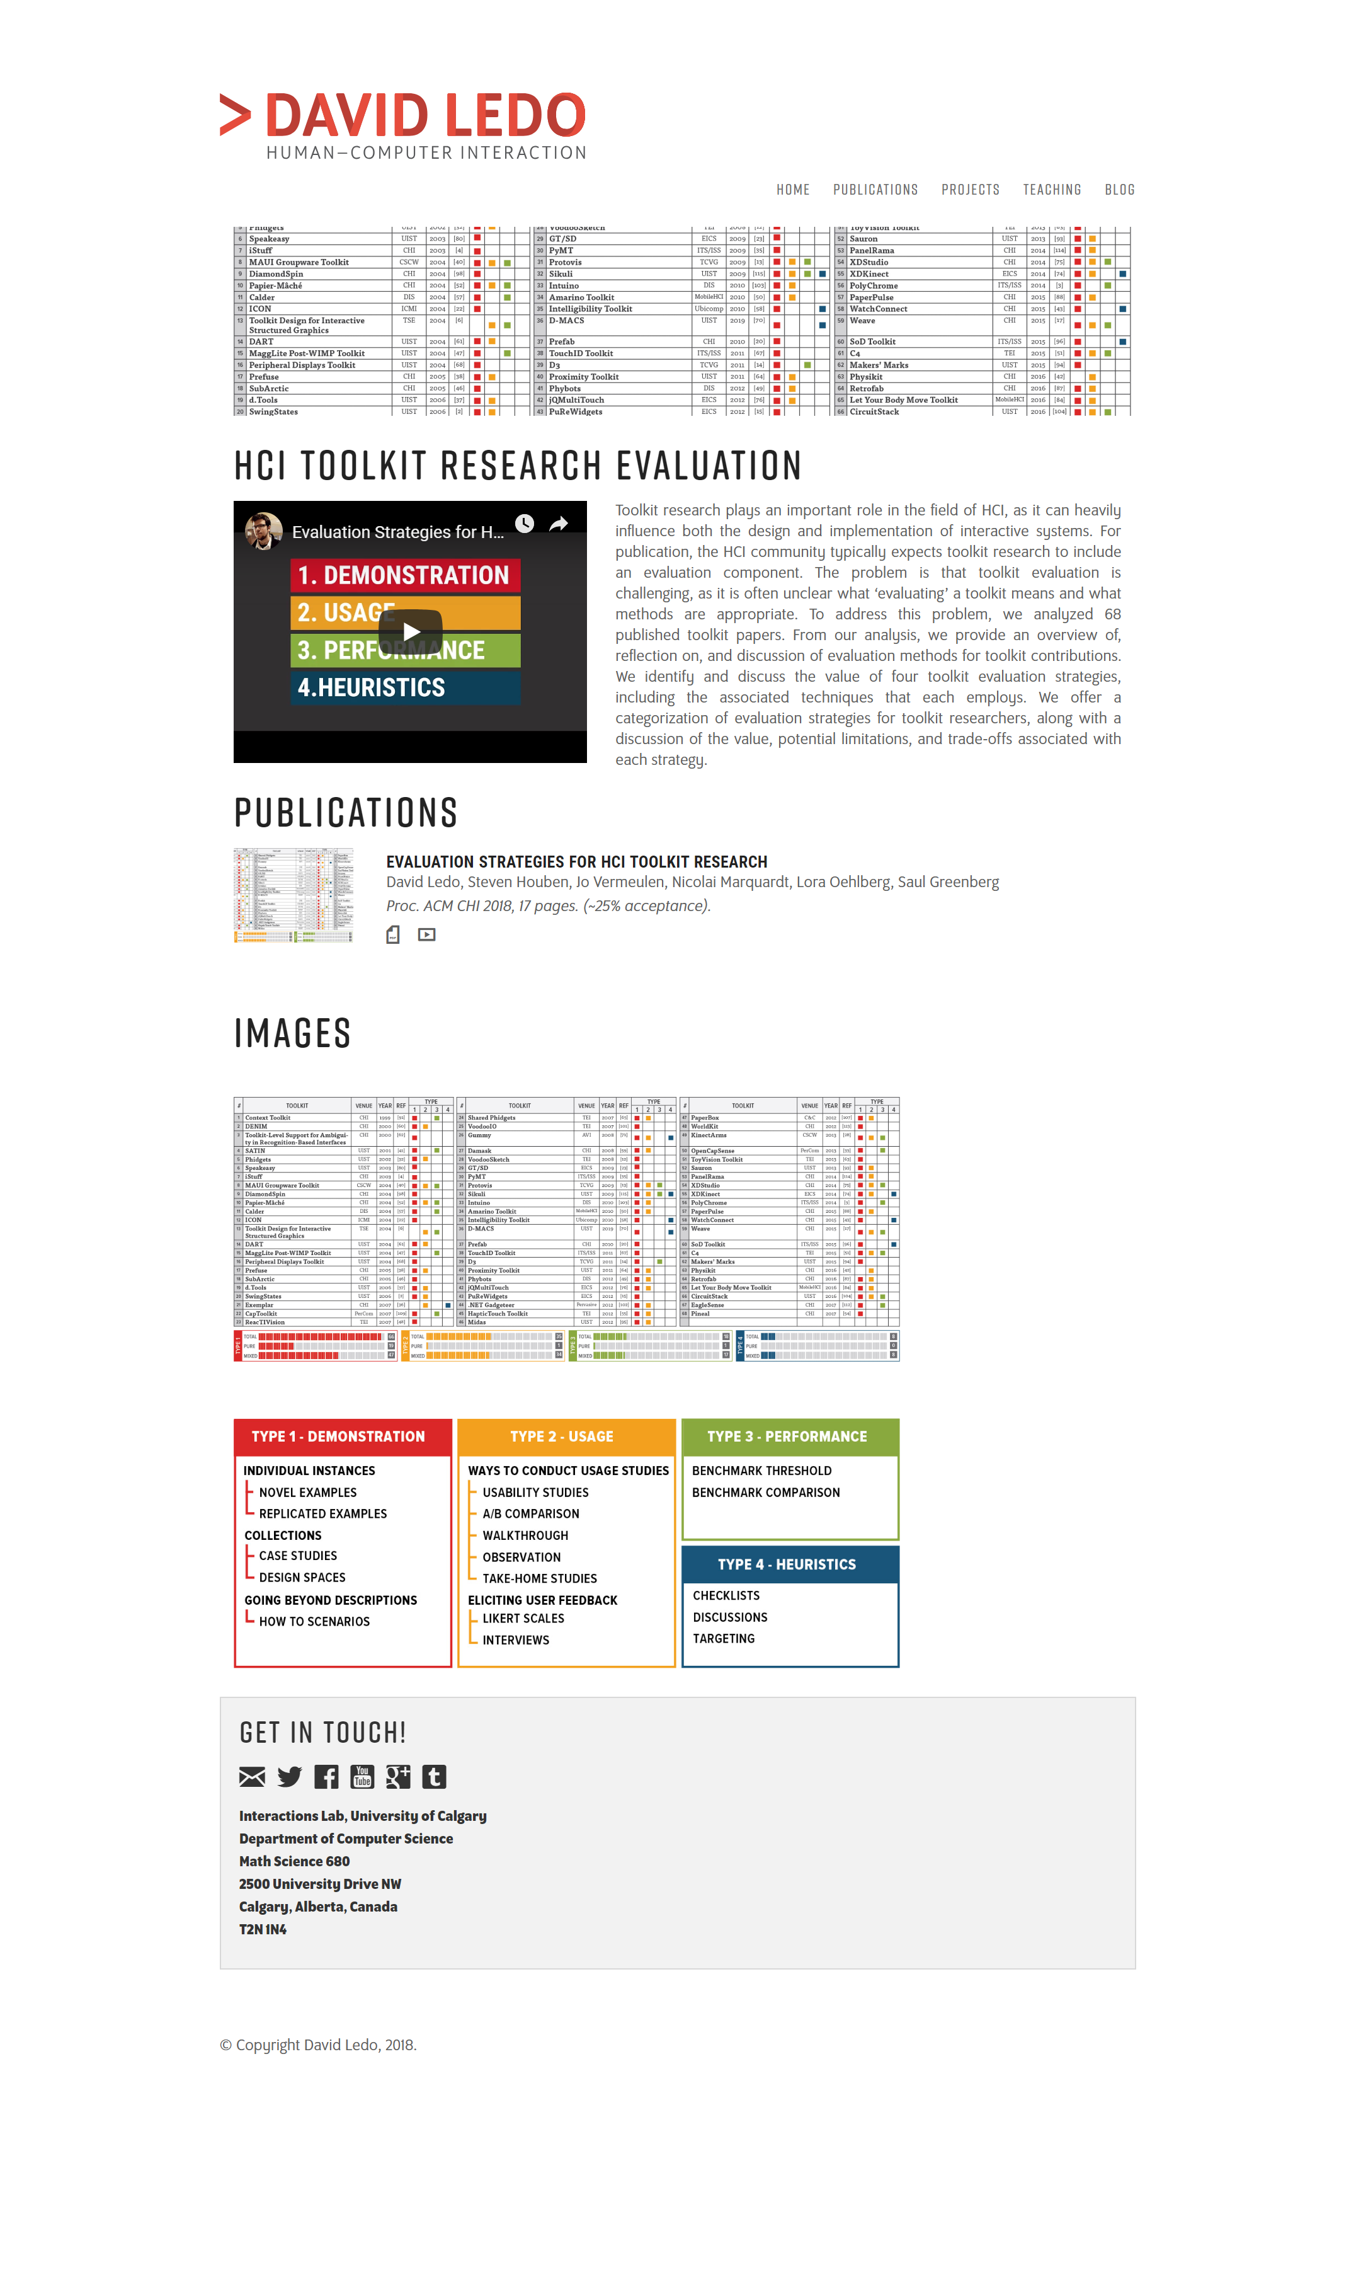
Notes:
http://davidledo.com/projects/project.html?toolkit-evaluation

Slide 59
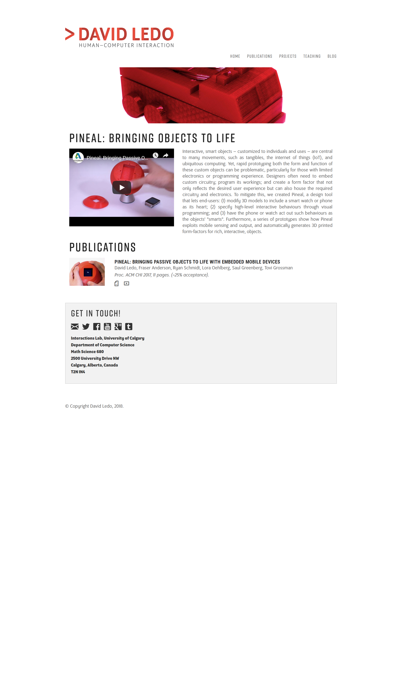

Slide 60
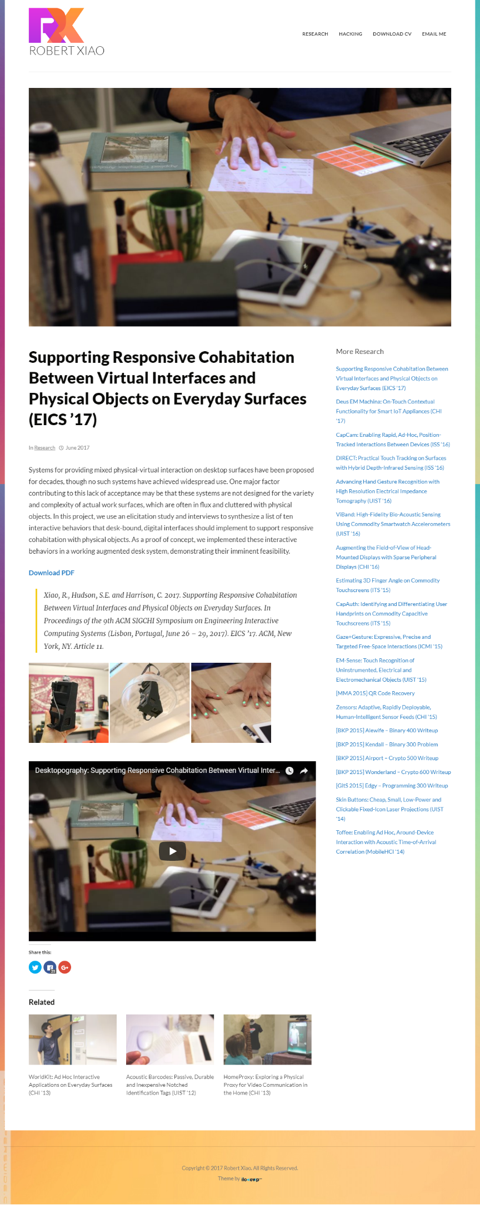
Notes:
https://www.robertxiao.ca/research/desktopography/

Slide 61


Slide 62

Notes:
http://larstornoe.com/work/bloc/

Slide 63

Notes:
http://brandexponents.com/oshin/blog/portfolio/left-floating-sidebar/

Slide 64


Slide 65
News

Slide 66

Notes:
http://morphingmatter.cs.cmu.edu/news/

Slide 67
Example Footers

Slide 68

I like the recent post idea. Could use it for recent news.

Slide 69


Slide 70
Other Inspiration

Slide 71

I like use of date box here to simplify caption
From: http://pixelhint.com/demo/sublime/

Slide 72

I love this font. Feels so clean. Crisp. It’s called Raleway.
Notes:
http://designlab.ucsd.edu/#events-news

Slide 73

I also like this font. It’s called Lato.

